Slide 1


Sustainable Development Goals (SDGs)

Slide 2
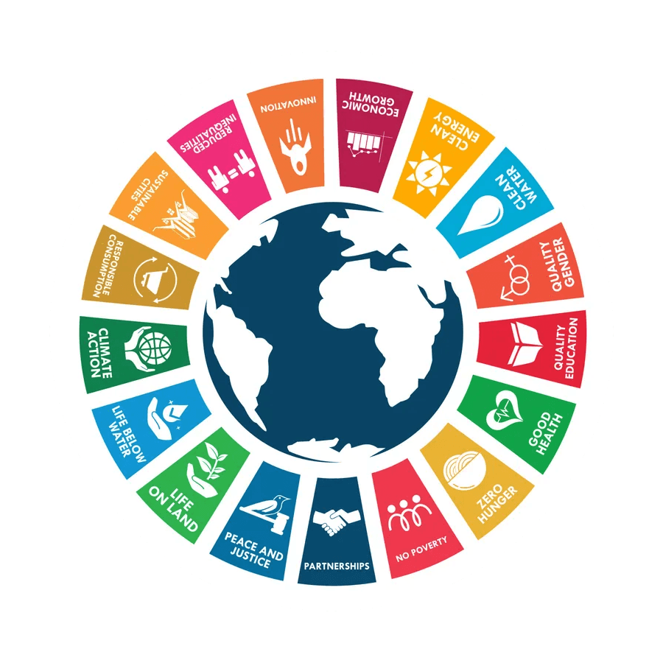
What are the Sustainable Development Goals?
Goal 17 focuses on strengthening global partnerships for sustainable development. The 2030 Agenda calls for action from all countries to ensure no one is left behind, with cooperation between governments, the private sector, and civil society.
Developing countries face rising debt and economic challenges, worsened by COVID-19 and inflation. Despite increasing official development assistance (ODA), much of the funds in 2022 went to support refugees and Ukraine.
For success, countries must work together, and developed nations need to honor their ODA commitments.

Slide 3

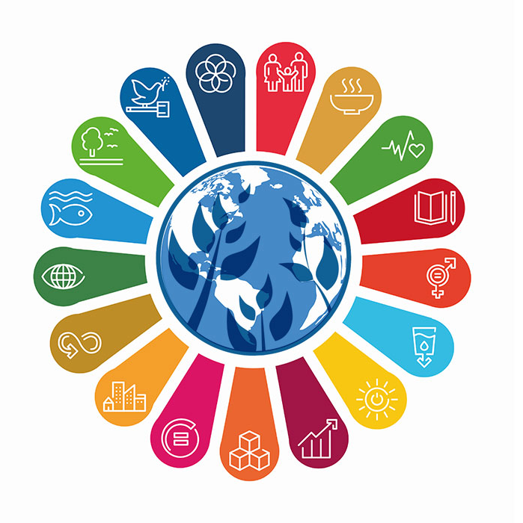
Background and Evolution of SDGs
The SDGs are built on previous international efforts:
1992 Earth Summit: Introduced Agenda 21, focusing on sustainable development.
2000 Millennium Development Goals (MDGs): Aimed at reducing extreme poverty by 2015.
2012 Rio+20 Conference: Laid the groundwork for the SDGs.
In 2015, global agreements like the Sendai Framework (disaster risk reduction), the Addis Ababa Action Agenda (development financing), and the Paris Agreement on Climate Change reinforced the commitment to sustainability.
Proposal: In 2013, the General Assembly set up a 30-member Open Working Group to develop a proposal on the SDGs.
Beginning: In January 2015, the General Assembly began the negotiation process on the post-2015 development agenda. The process concluded in the subsequent adoption of the 2030 Agenda for Sustainable Development, with 17 SDGs at its core, at the UN Sustainable Development Summit in September 2015.
The UN monitors SDG progress through the High-level Political Forum and supports nations via the Division for Sustainable Development Goals (DSDG), offering resources and fostering partnerships.
Achieving the SDGs requires a unified effort from governments, organizations, and individuals to create a fairer, greener, and more sustainable future for all.

Slide 4
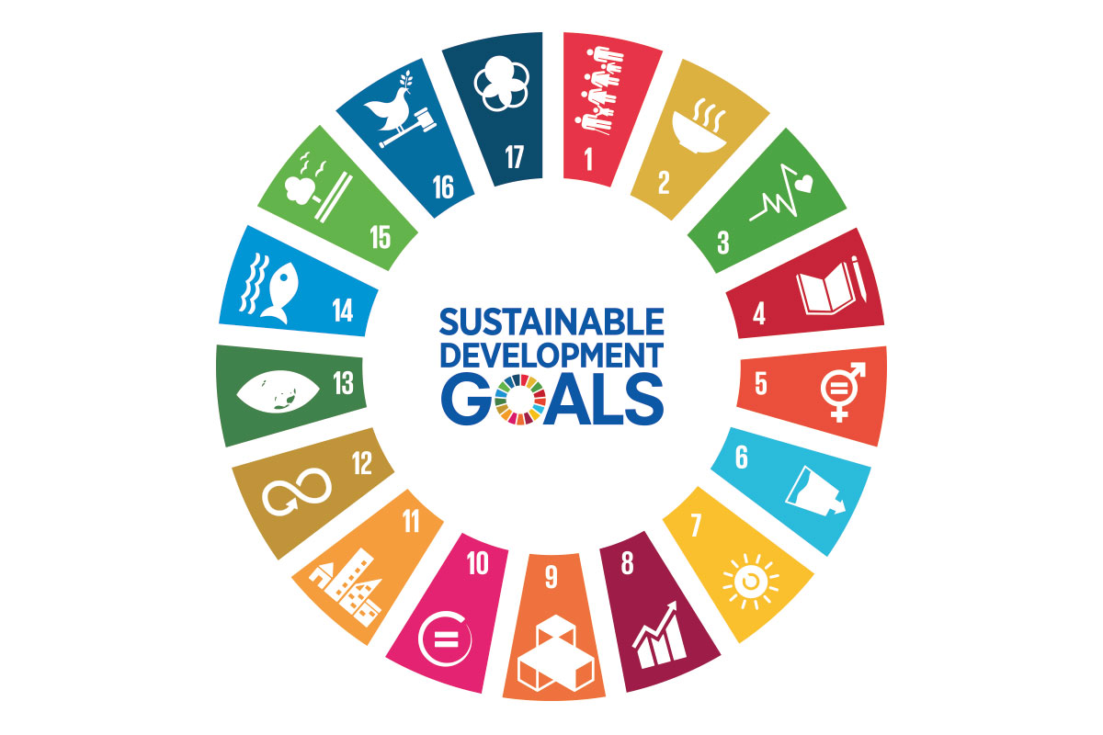
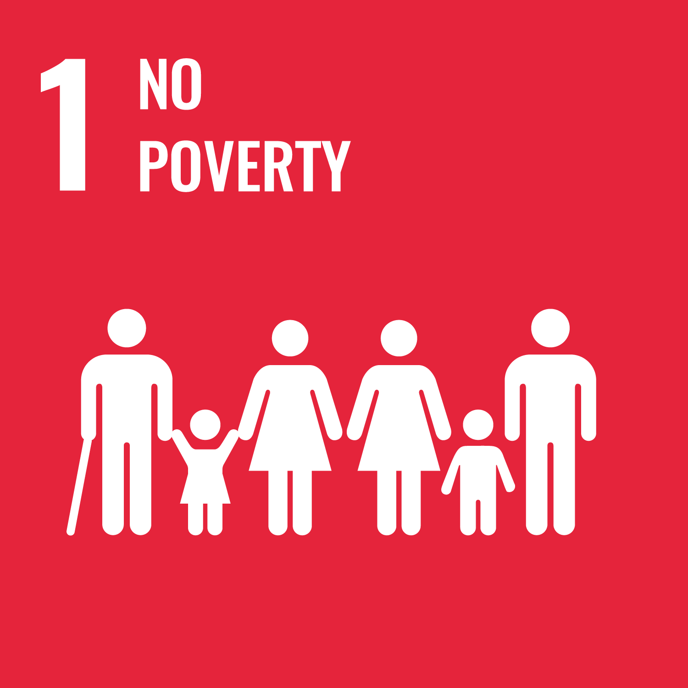
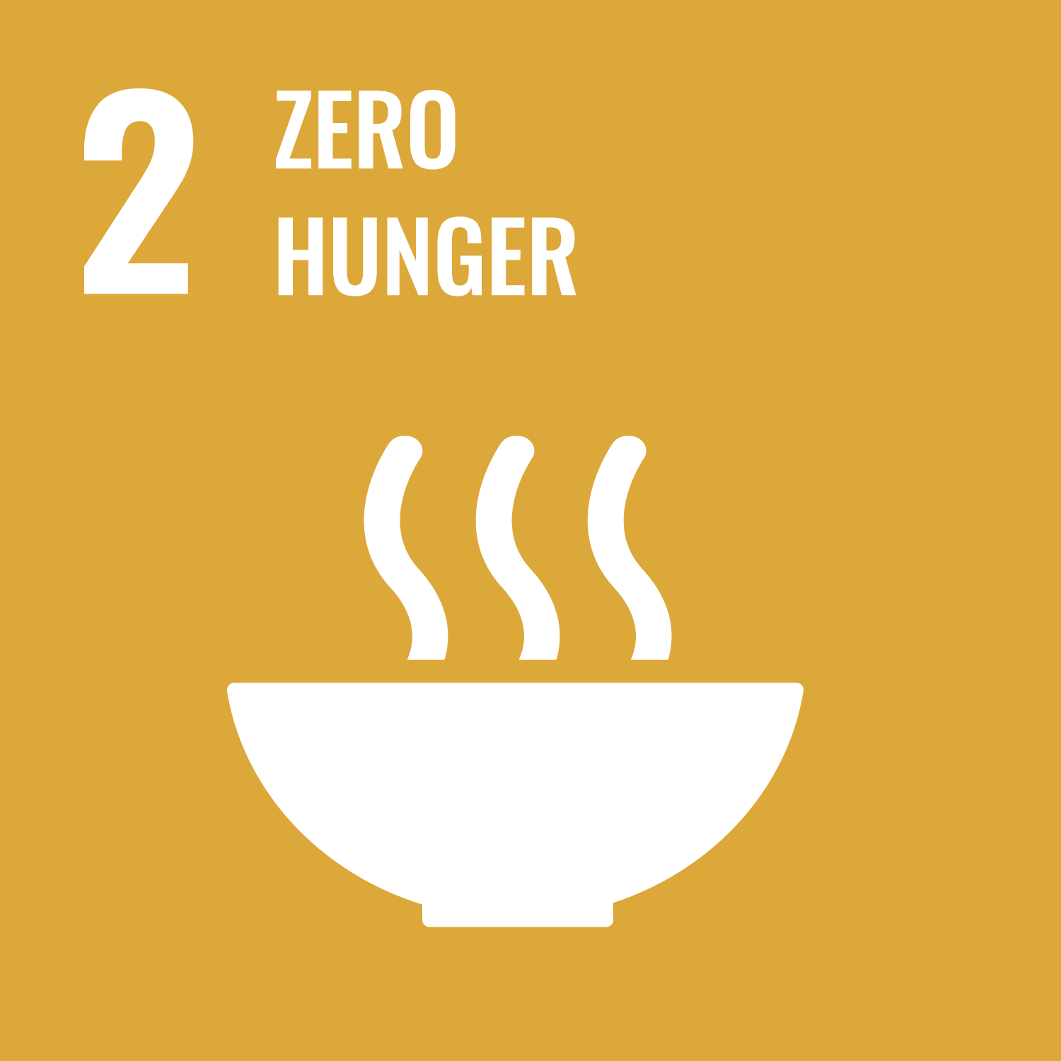
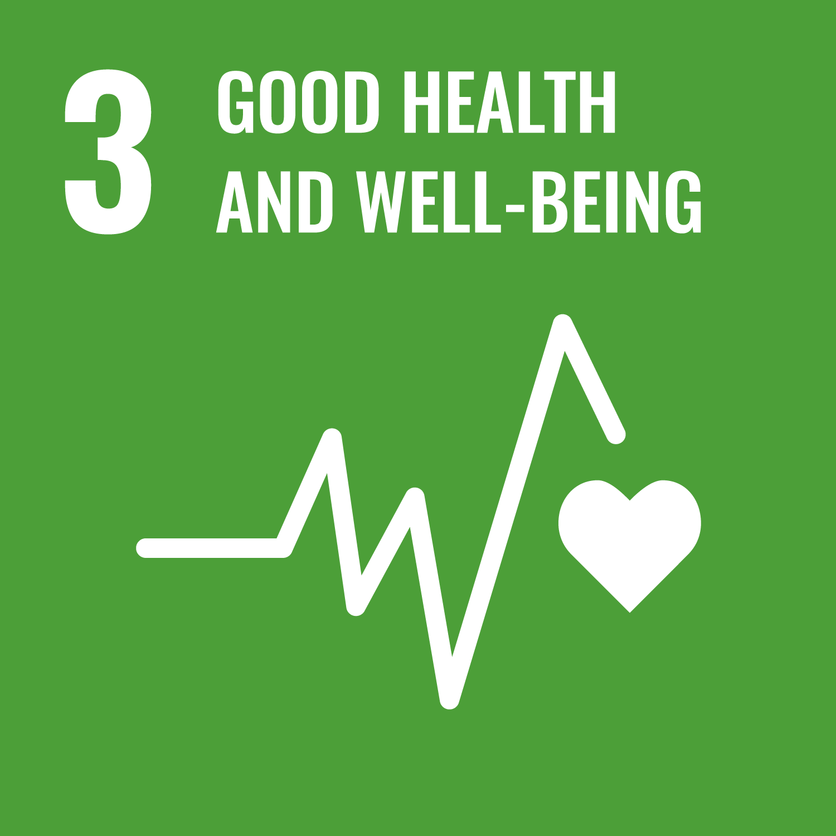
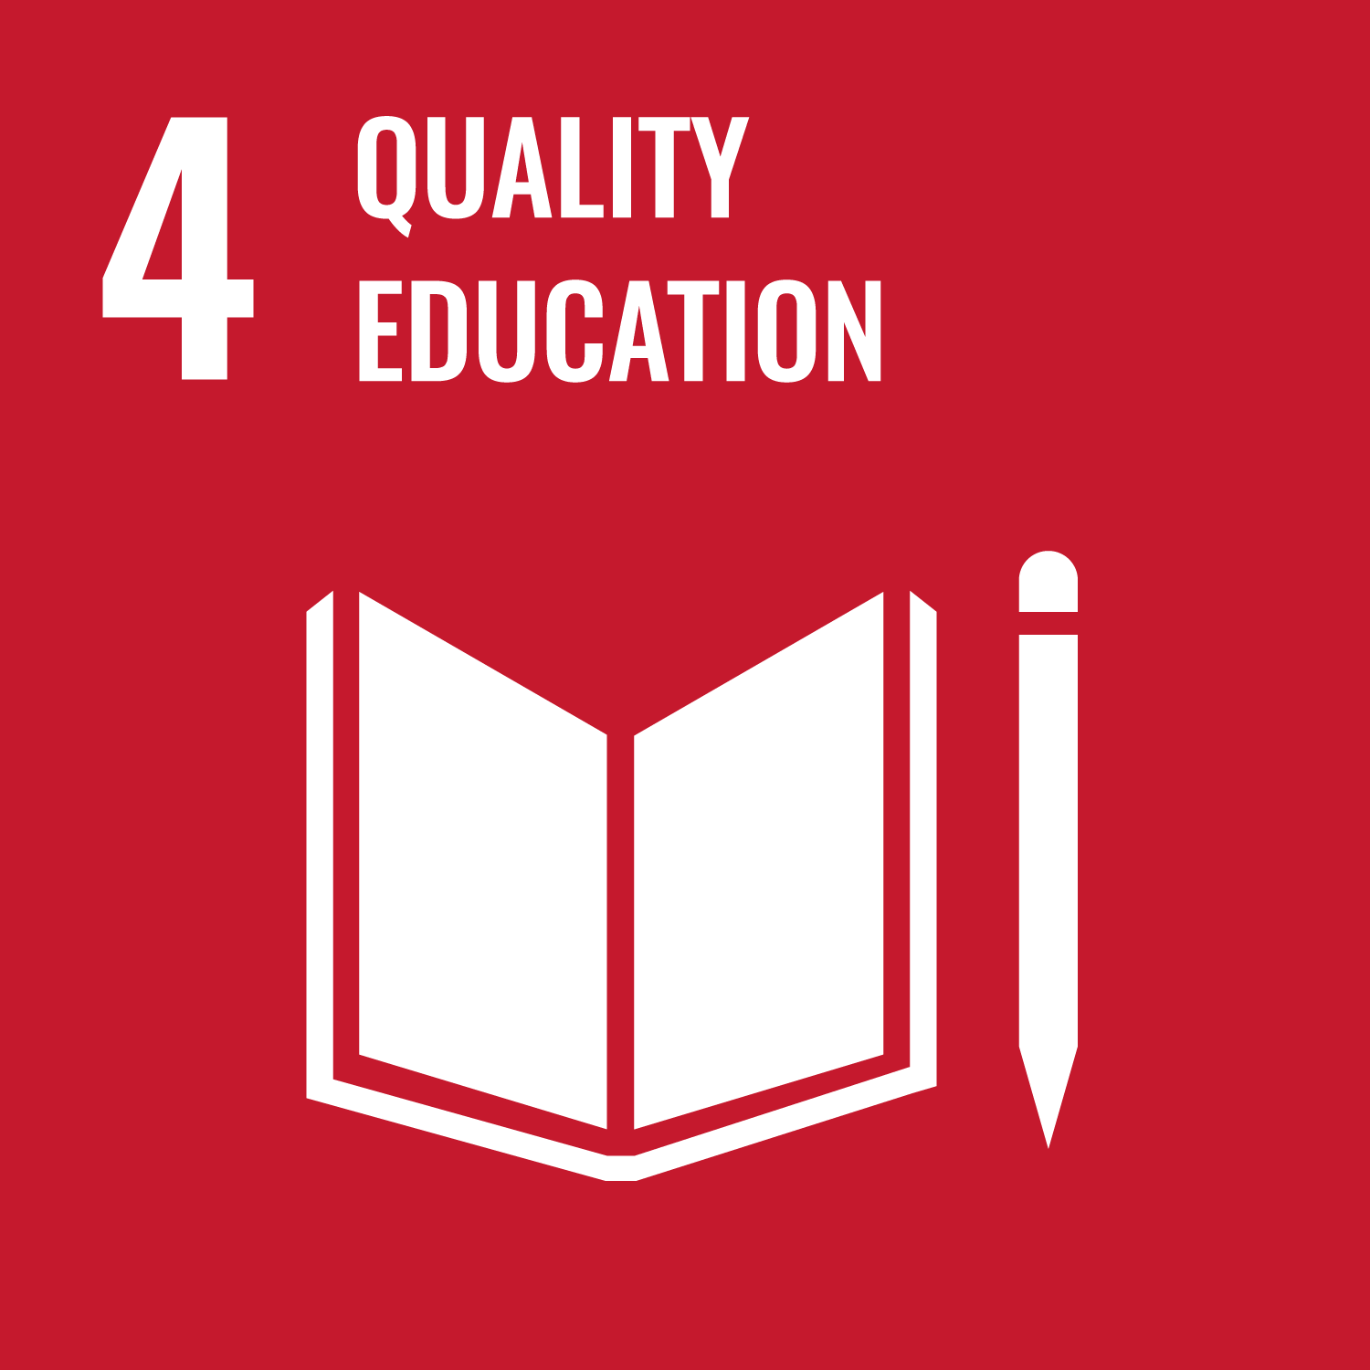
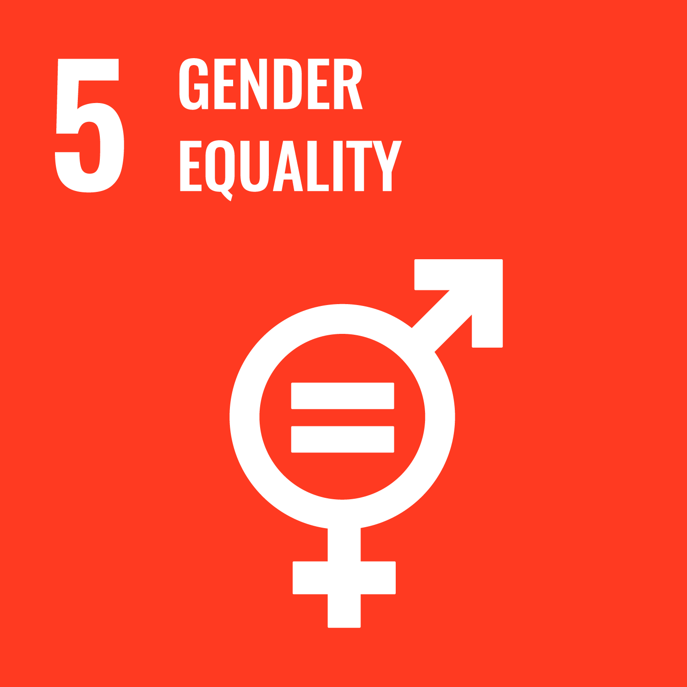
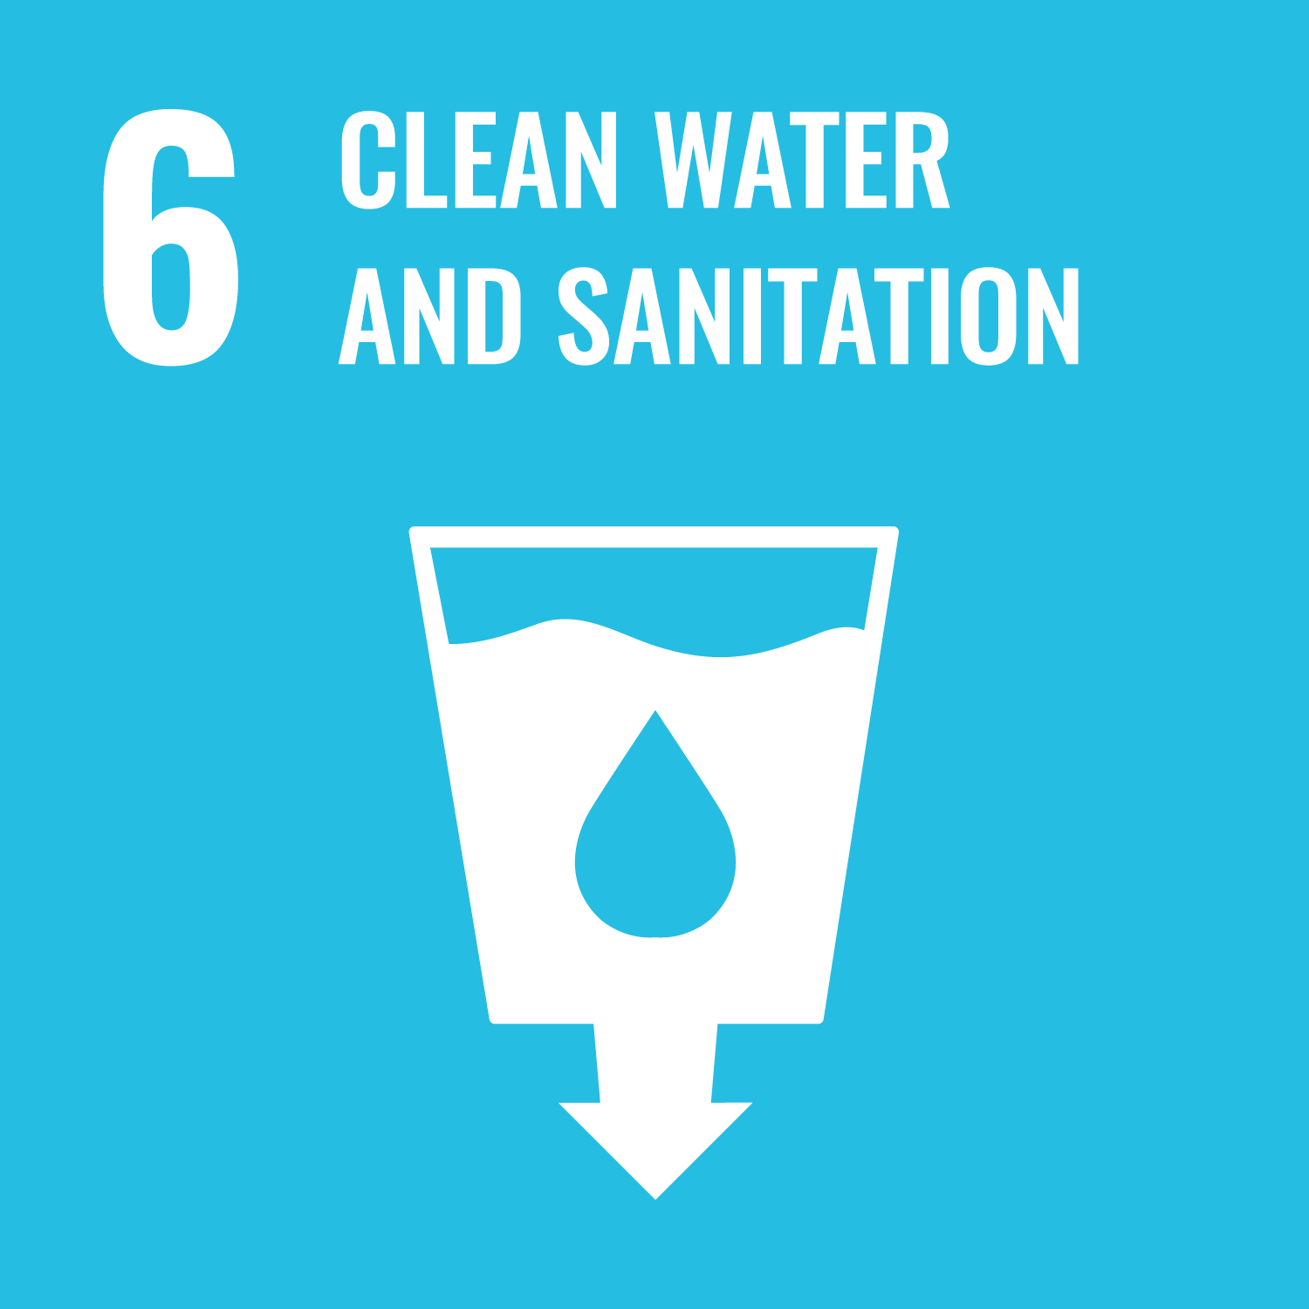
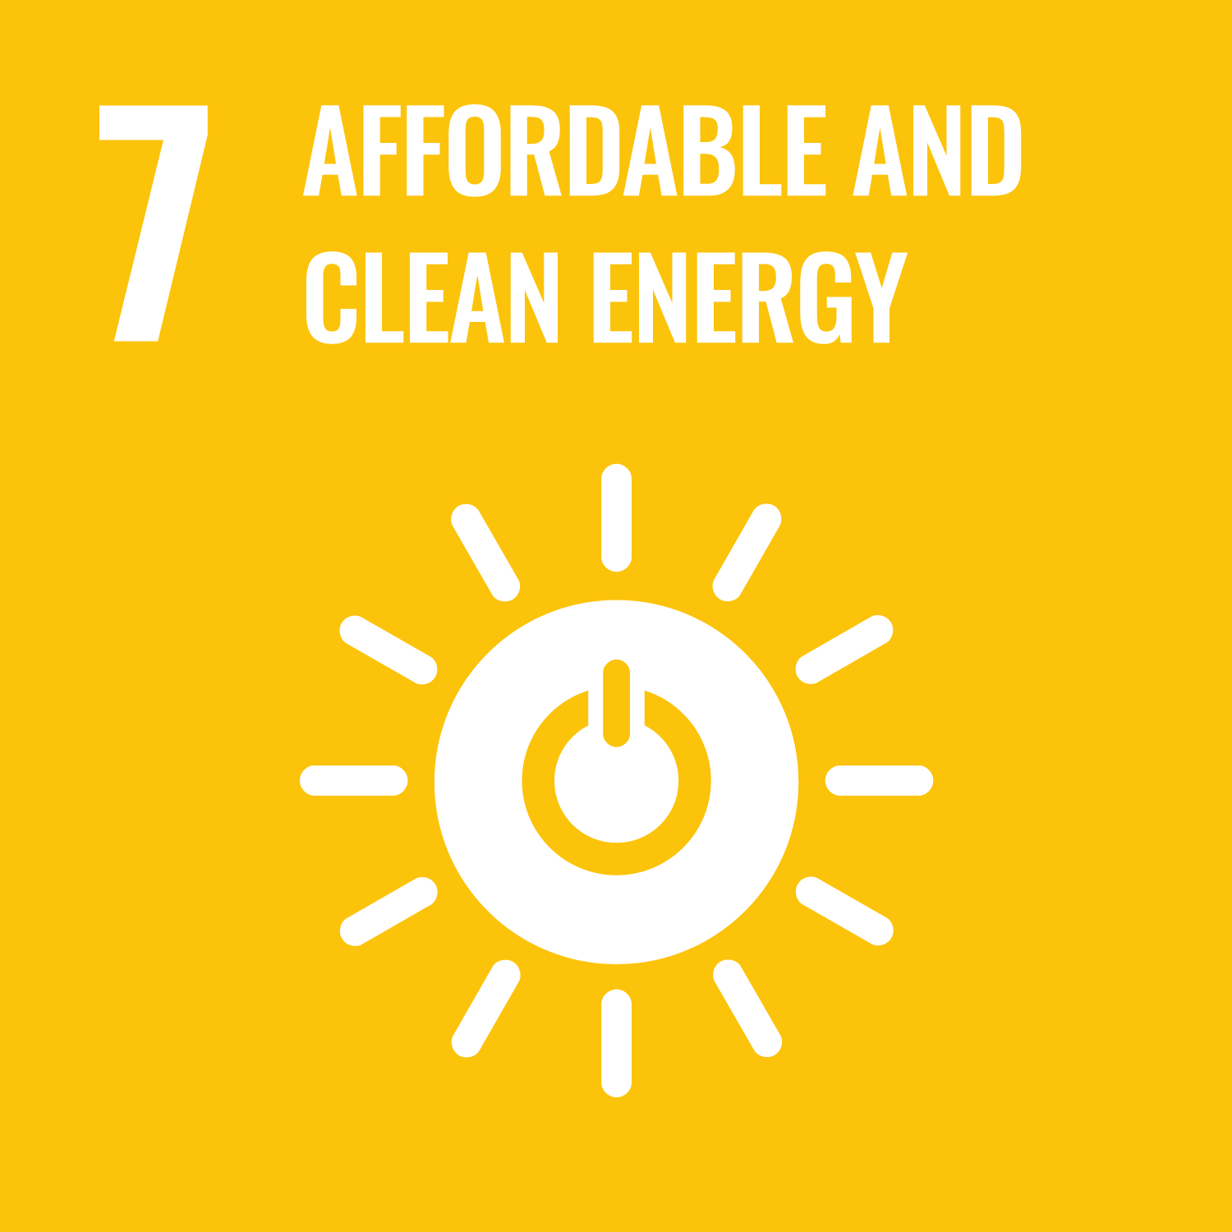
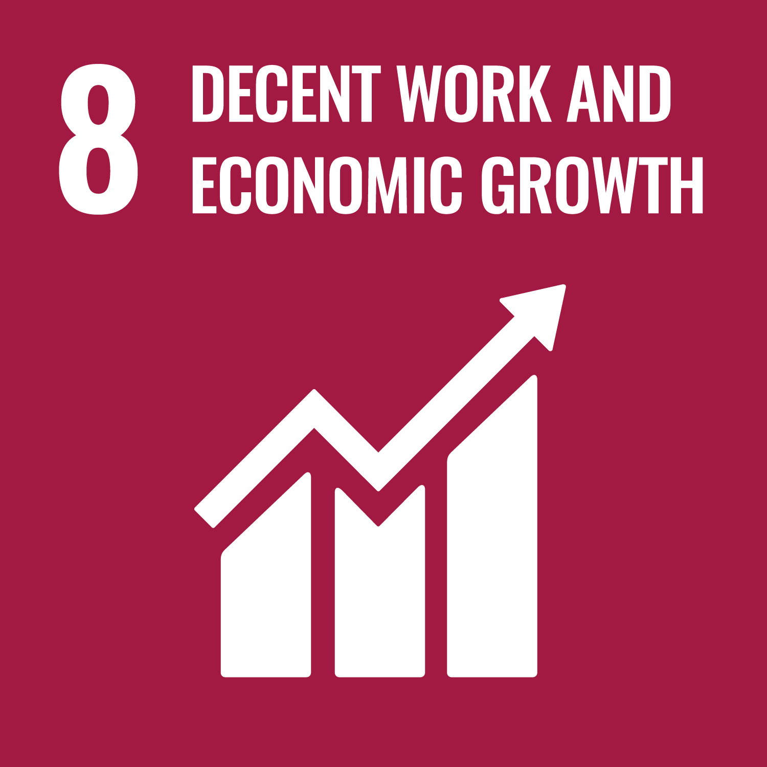
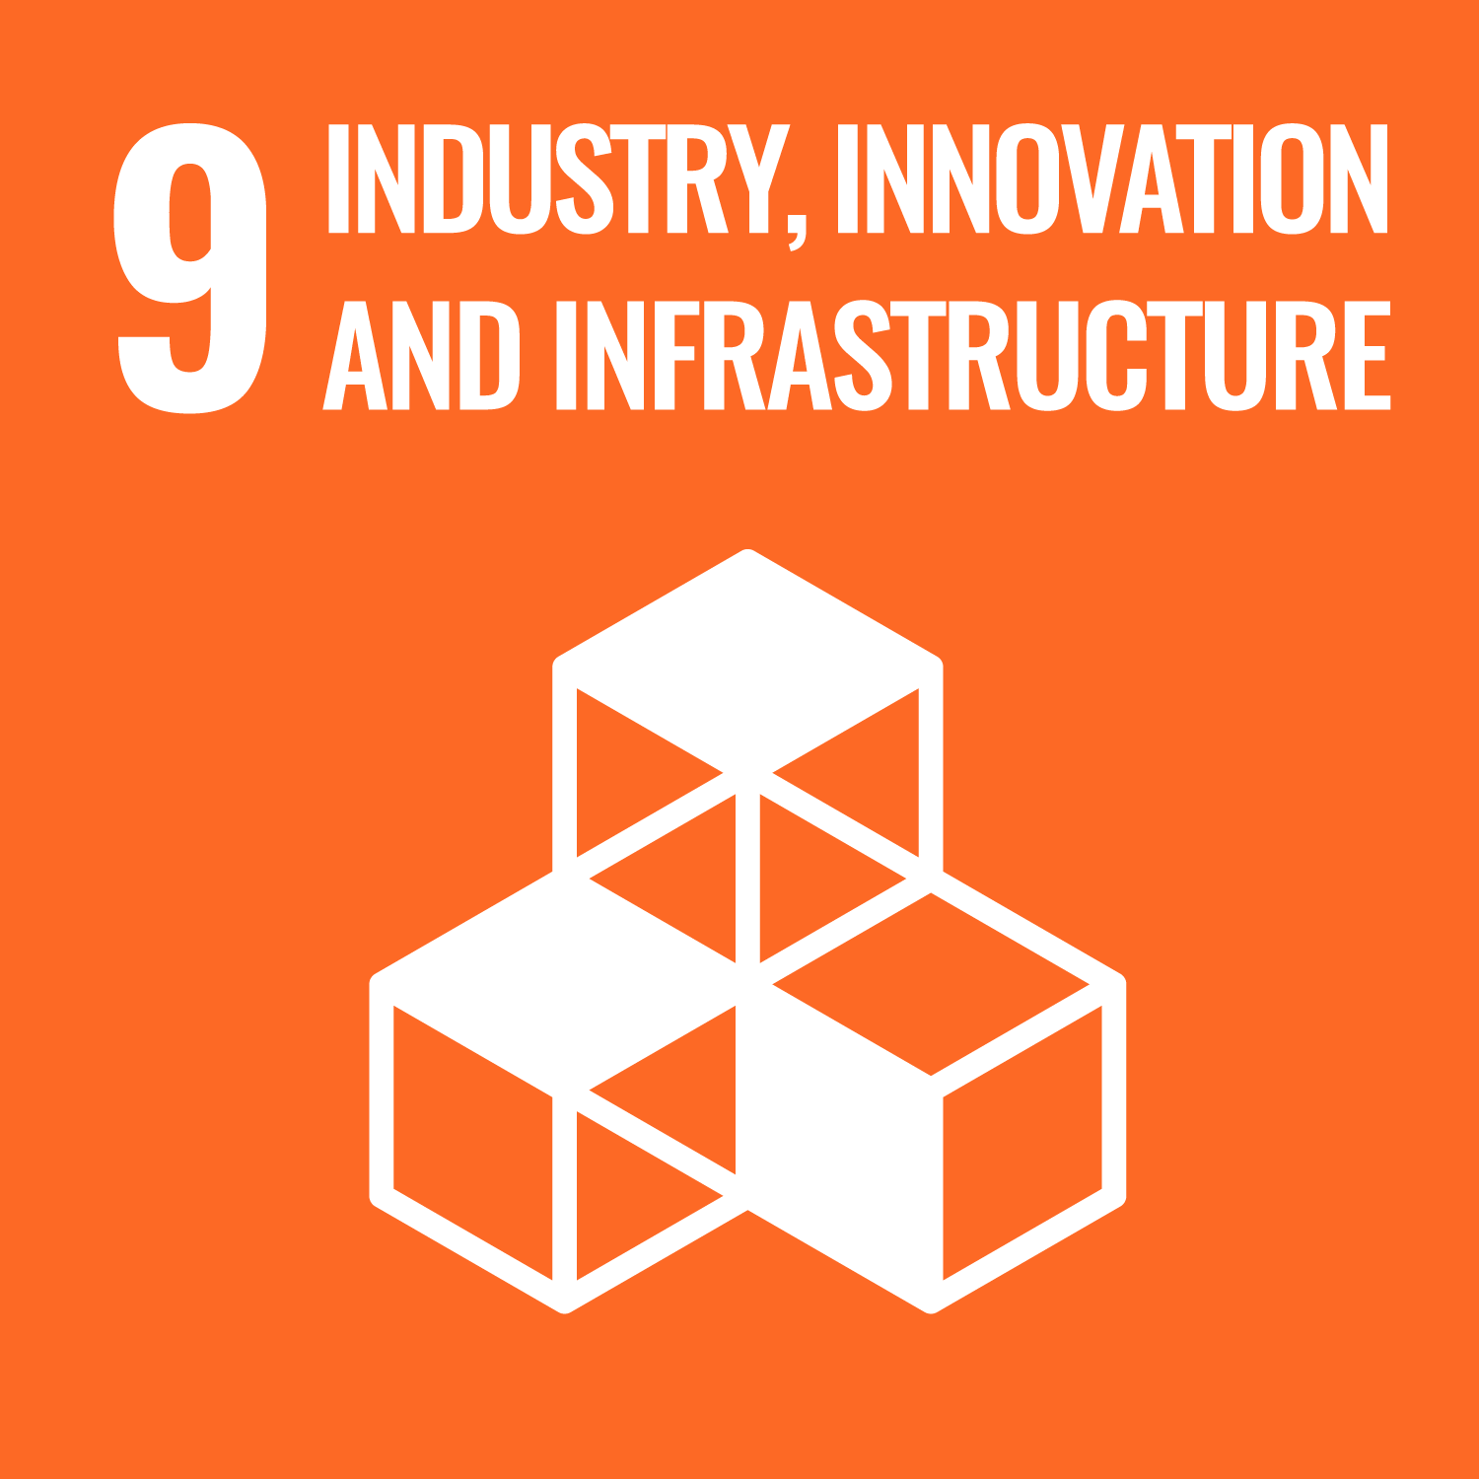
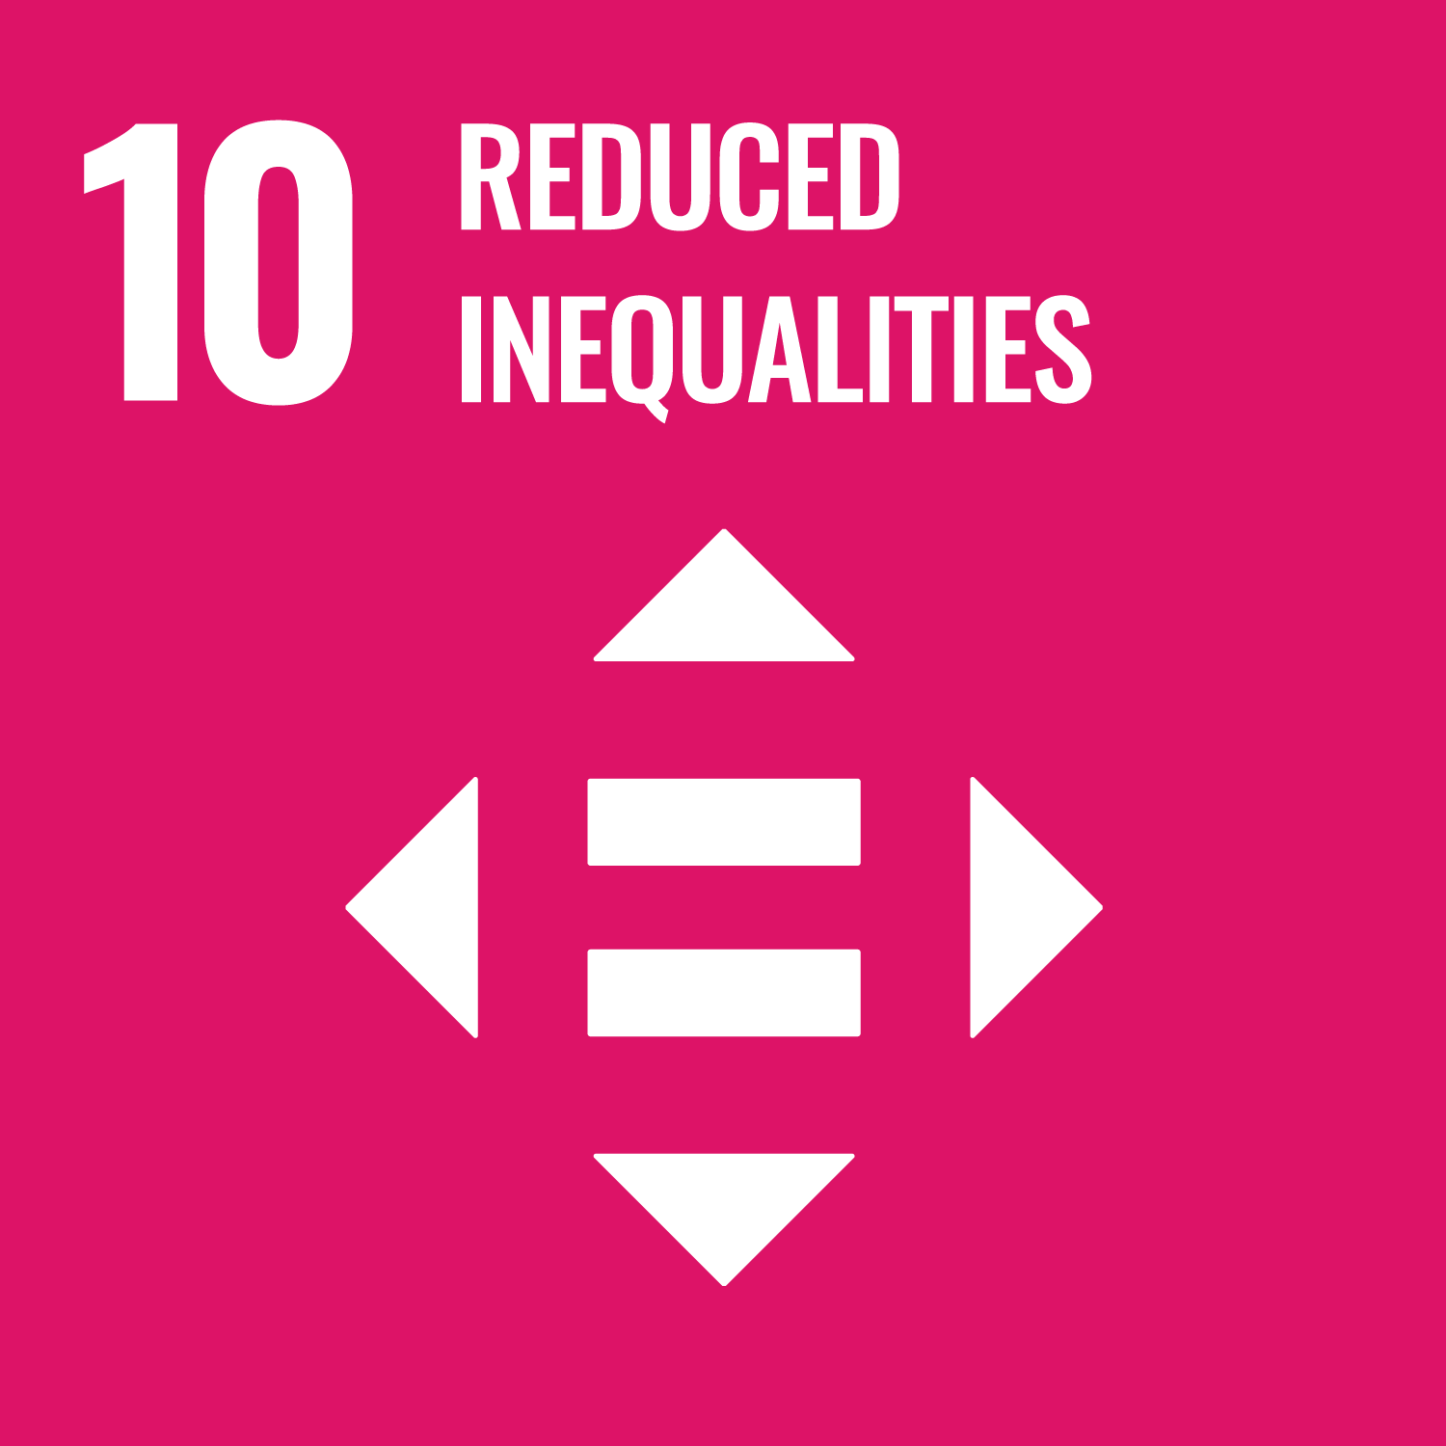
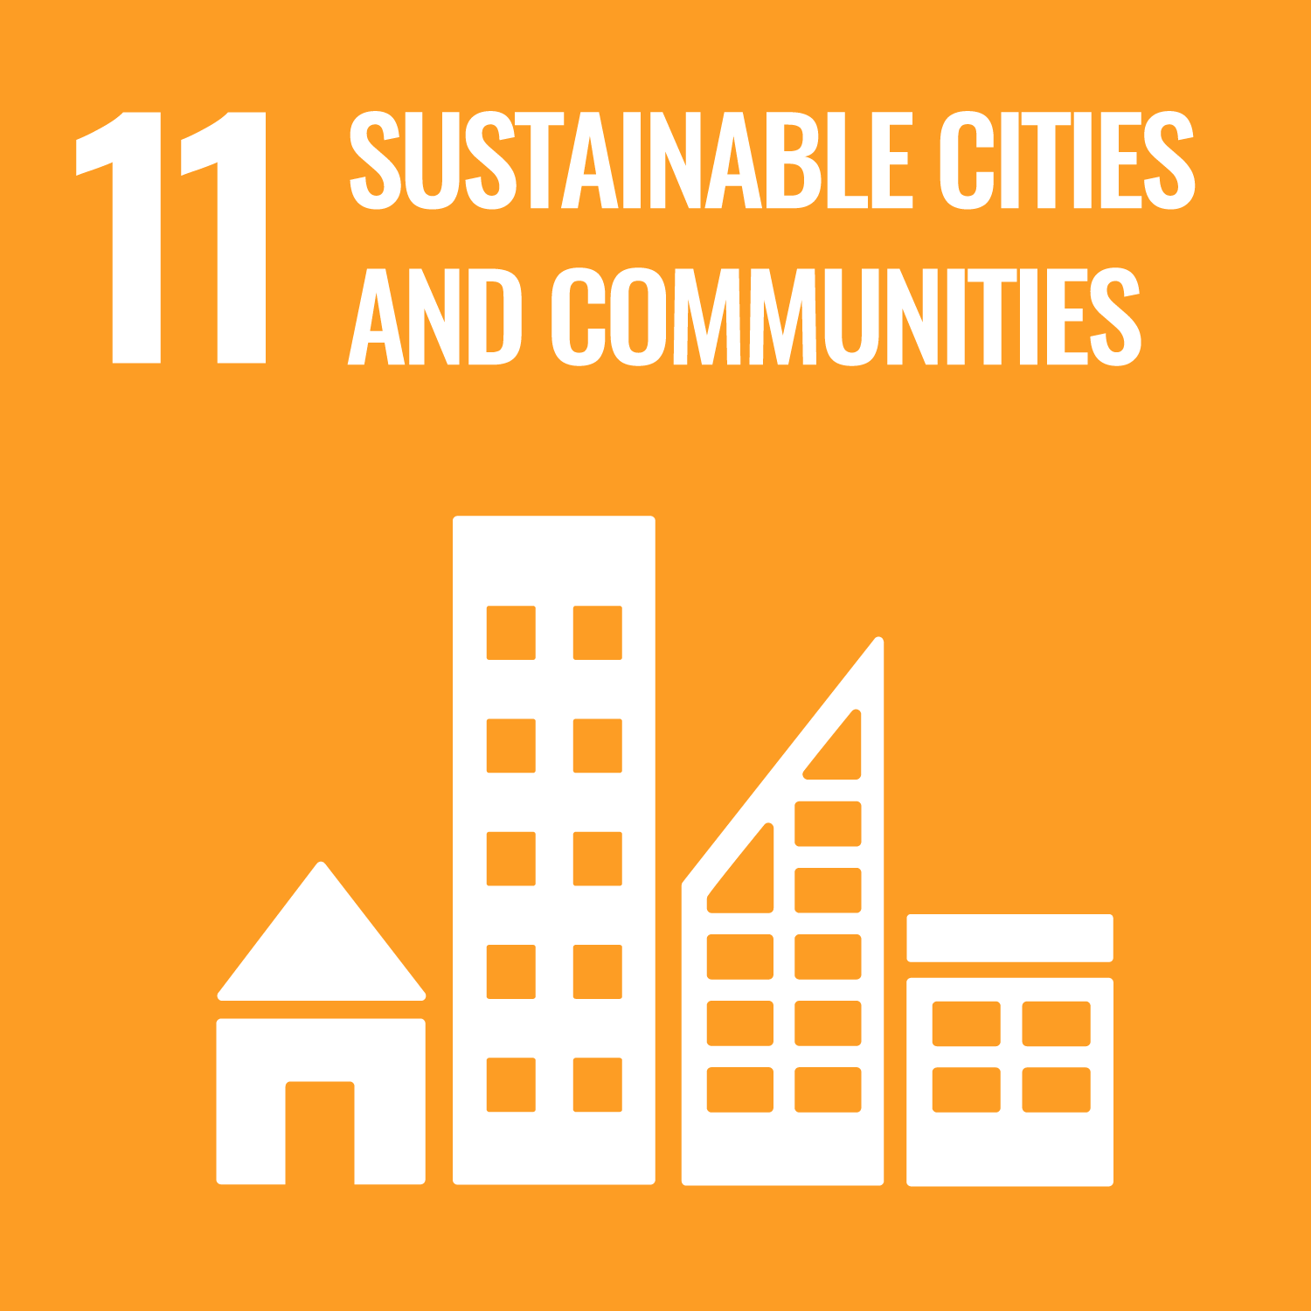
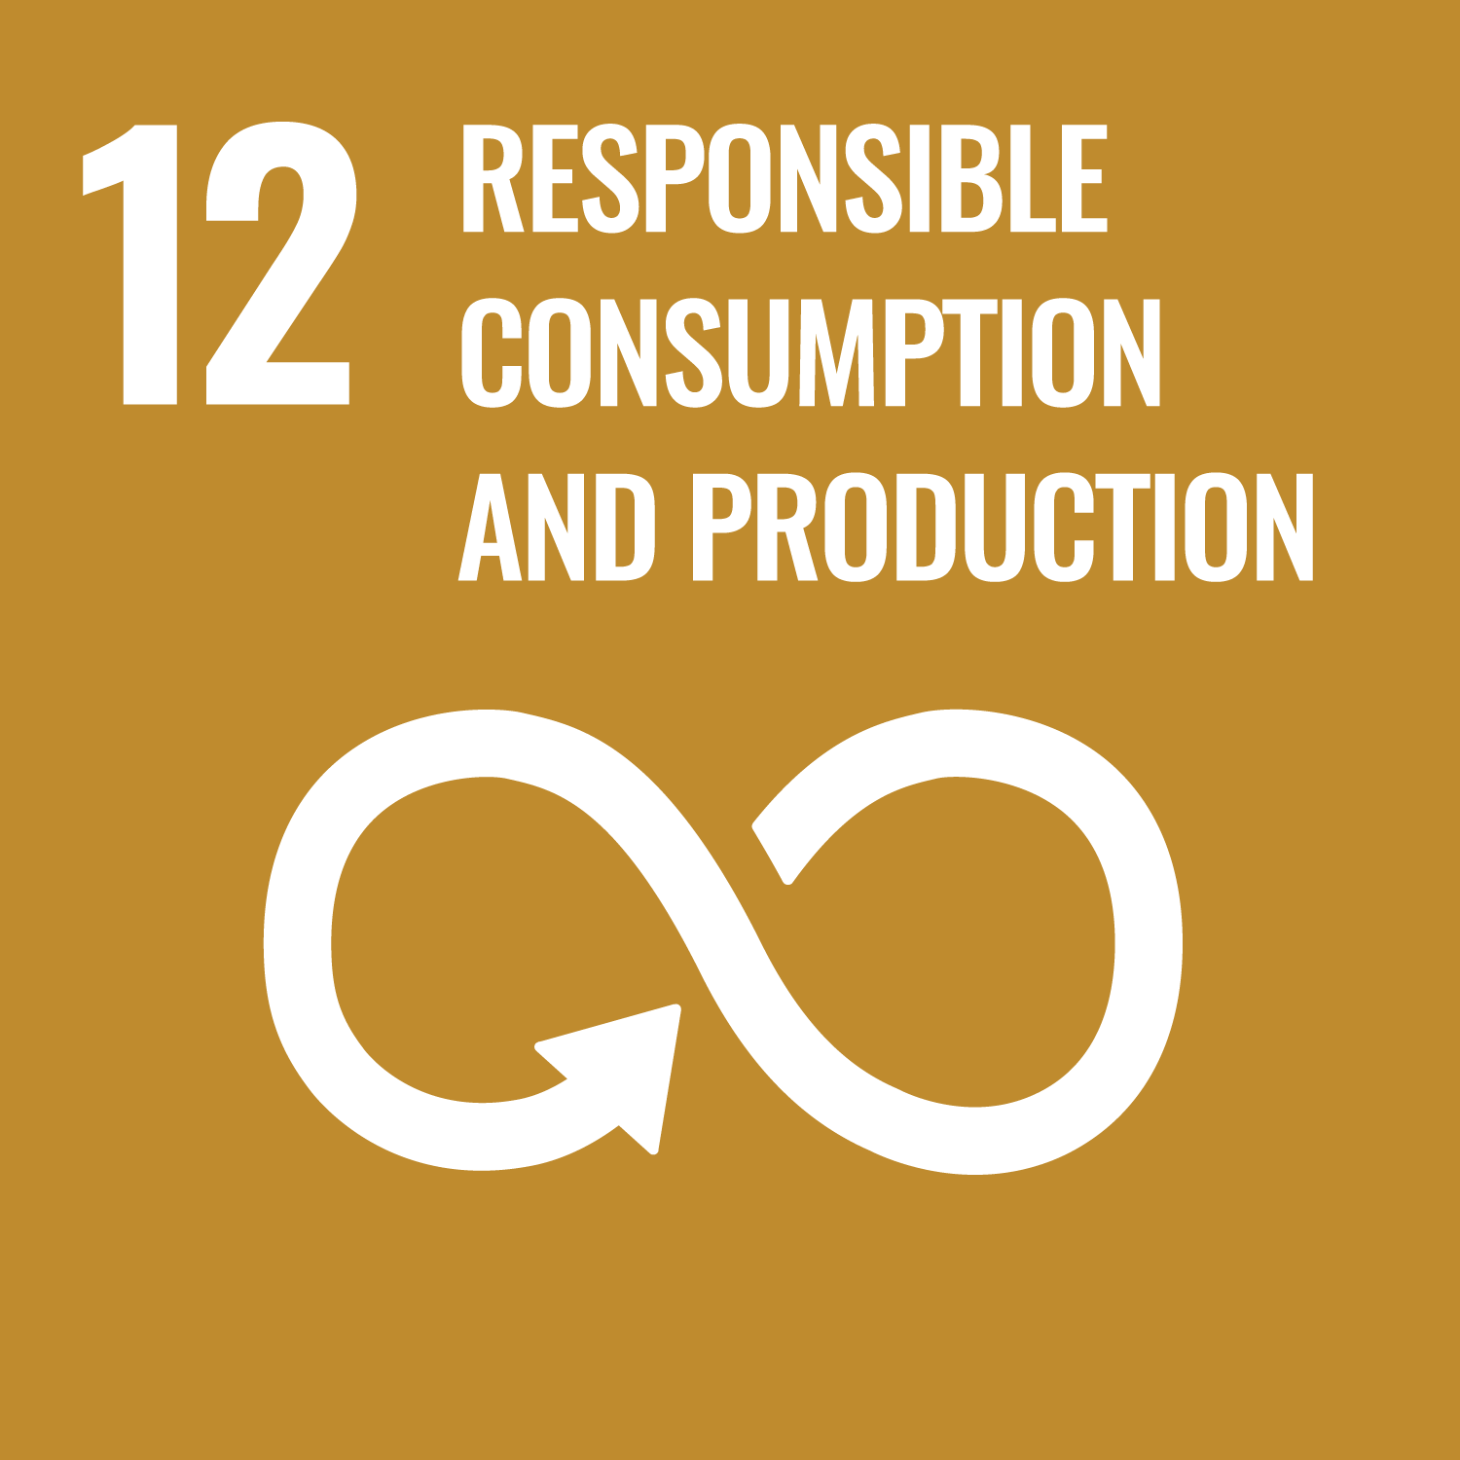
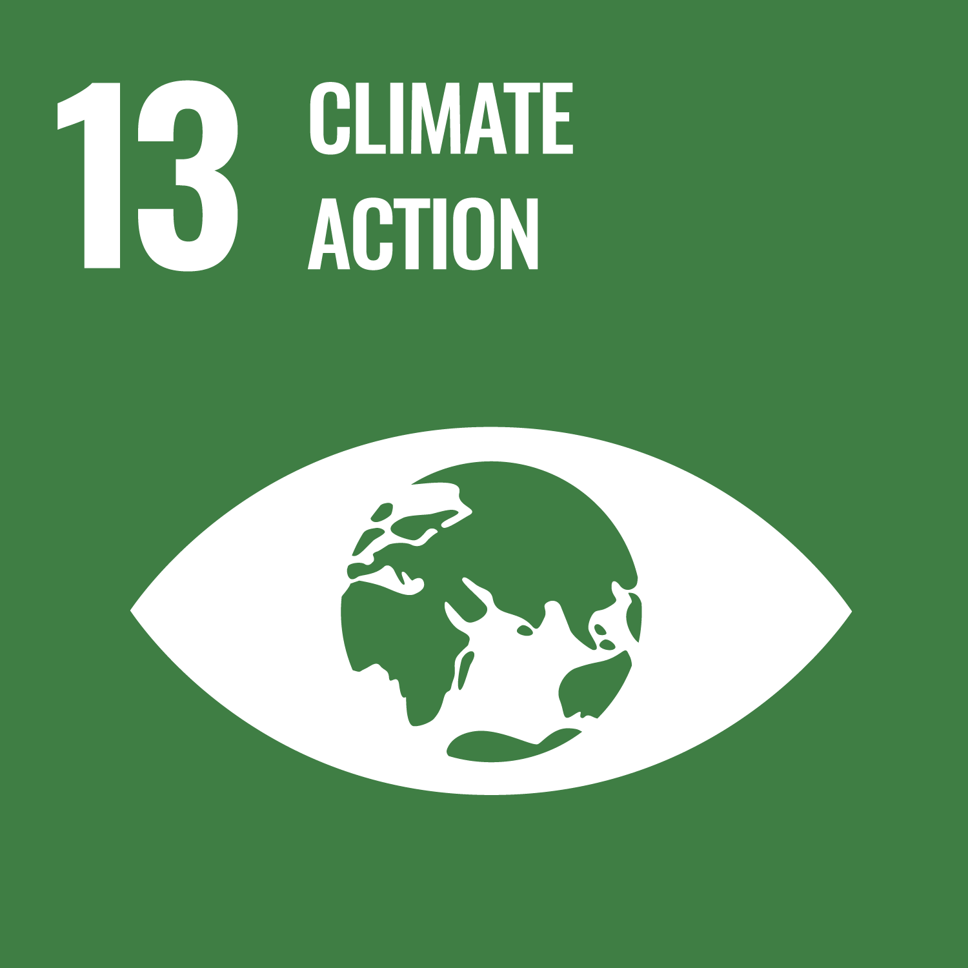
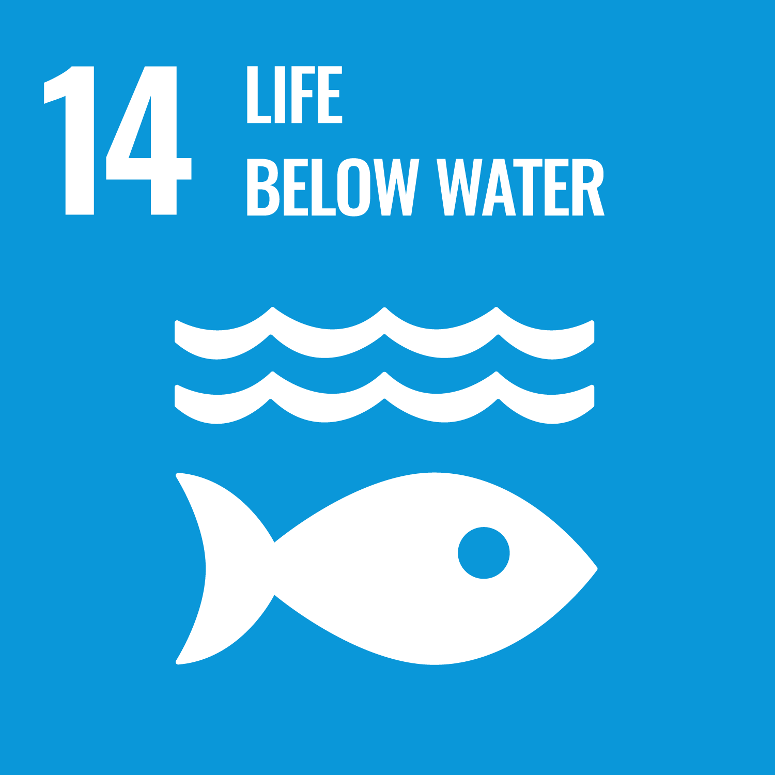
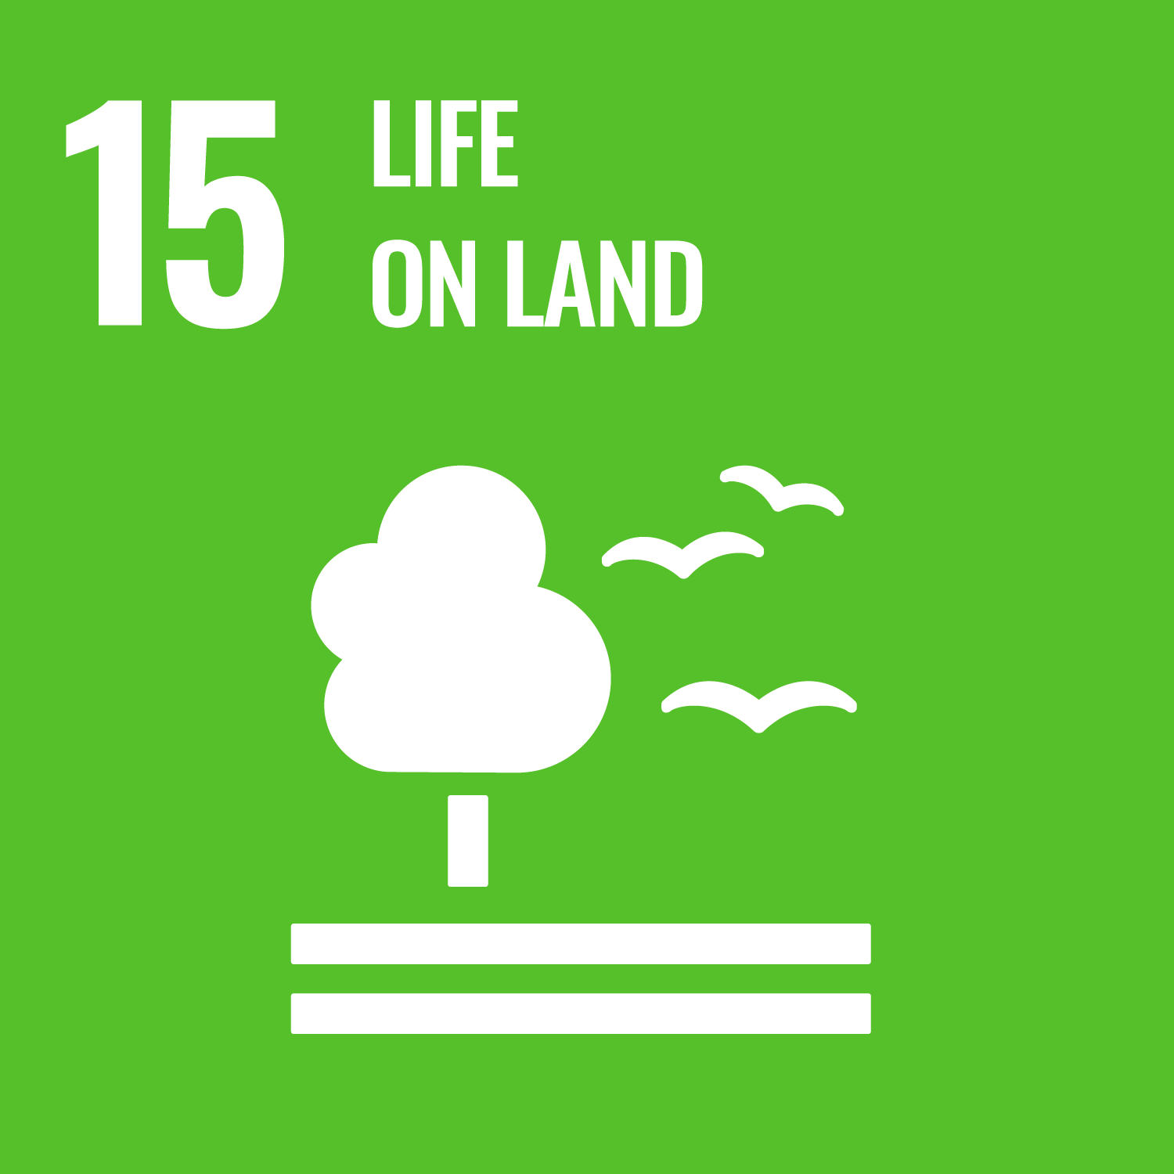

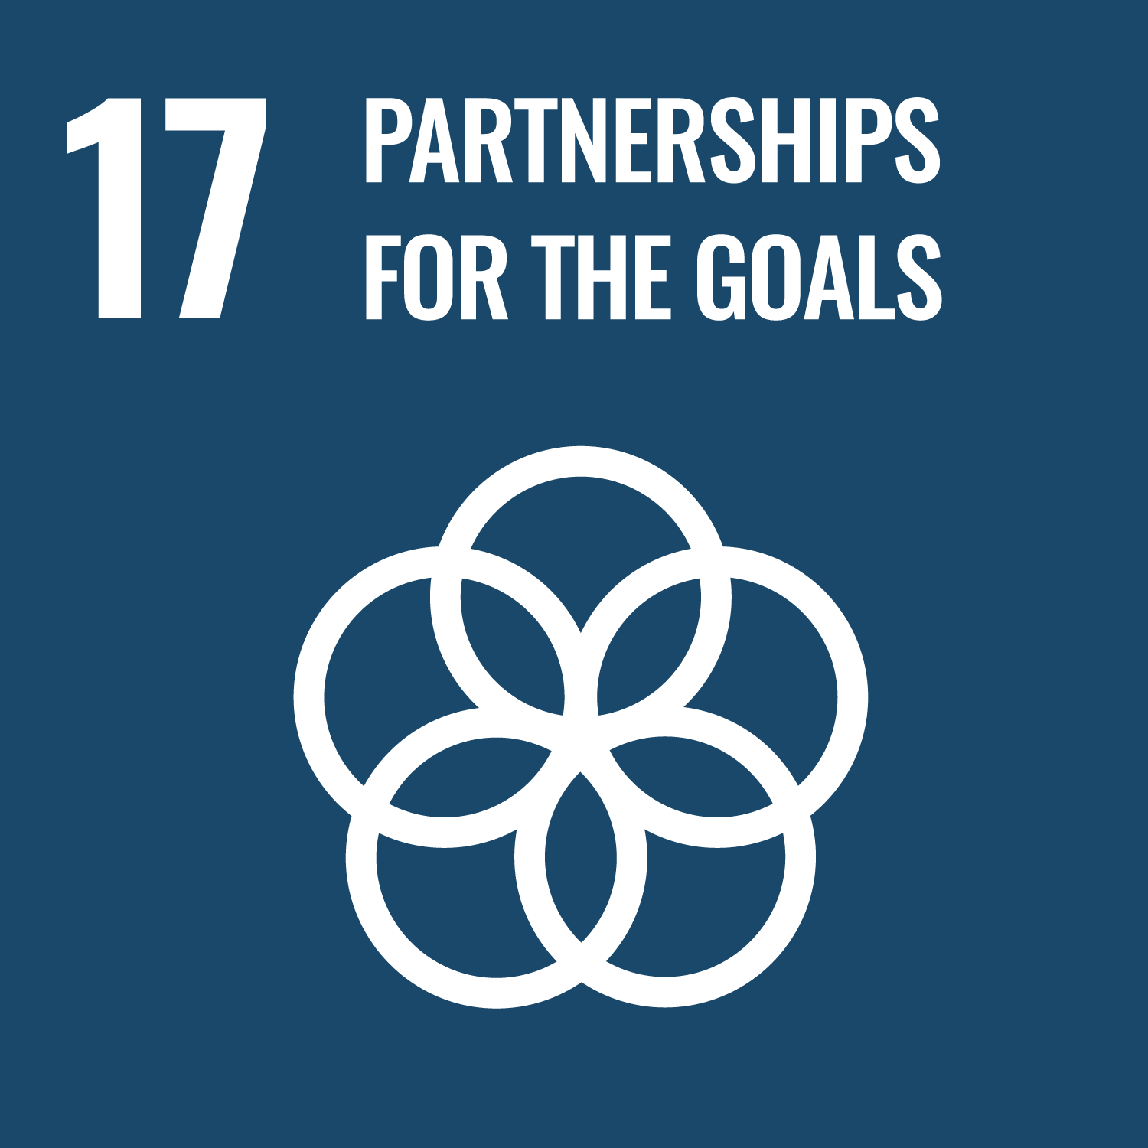
The 17 Goals

Slide 5
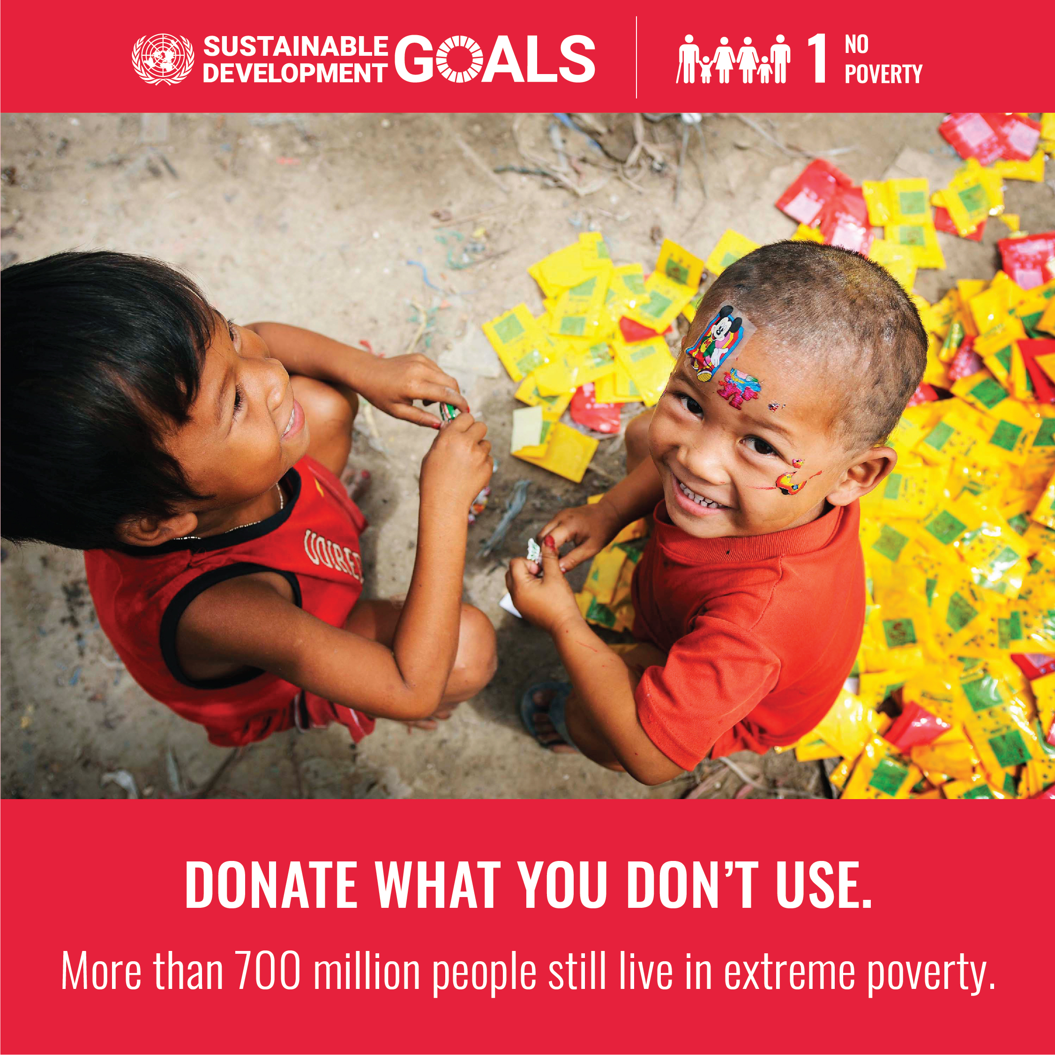
Goal 1 | No Poverty
Eradicating extreme poverty, defined as living on less than $2.15 per day, is a key goal of the 2030 Agenda for Sustainable Development. Despite significant progress in reducing poverty over past decades, the COVID-19 pandemic reversed these gains, adding nearly 90 million people to extreme poverty and erasing three years of progress. By the end of 2022, 8.4% of the global population (670 million people) still lived in extreme poverty. If current trends continue, around 575 million people (7% of the population) may remain in extreme poverty by 2030, particularly in sub-Saharan Africa. Compounding this issue is a reappearance of hunger to 2005 levels and rising food prices, creating a dual crisis of poverty and food insecurity.

Slide 6
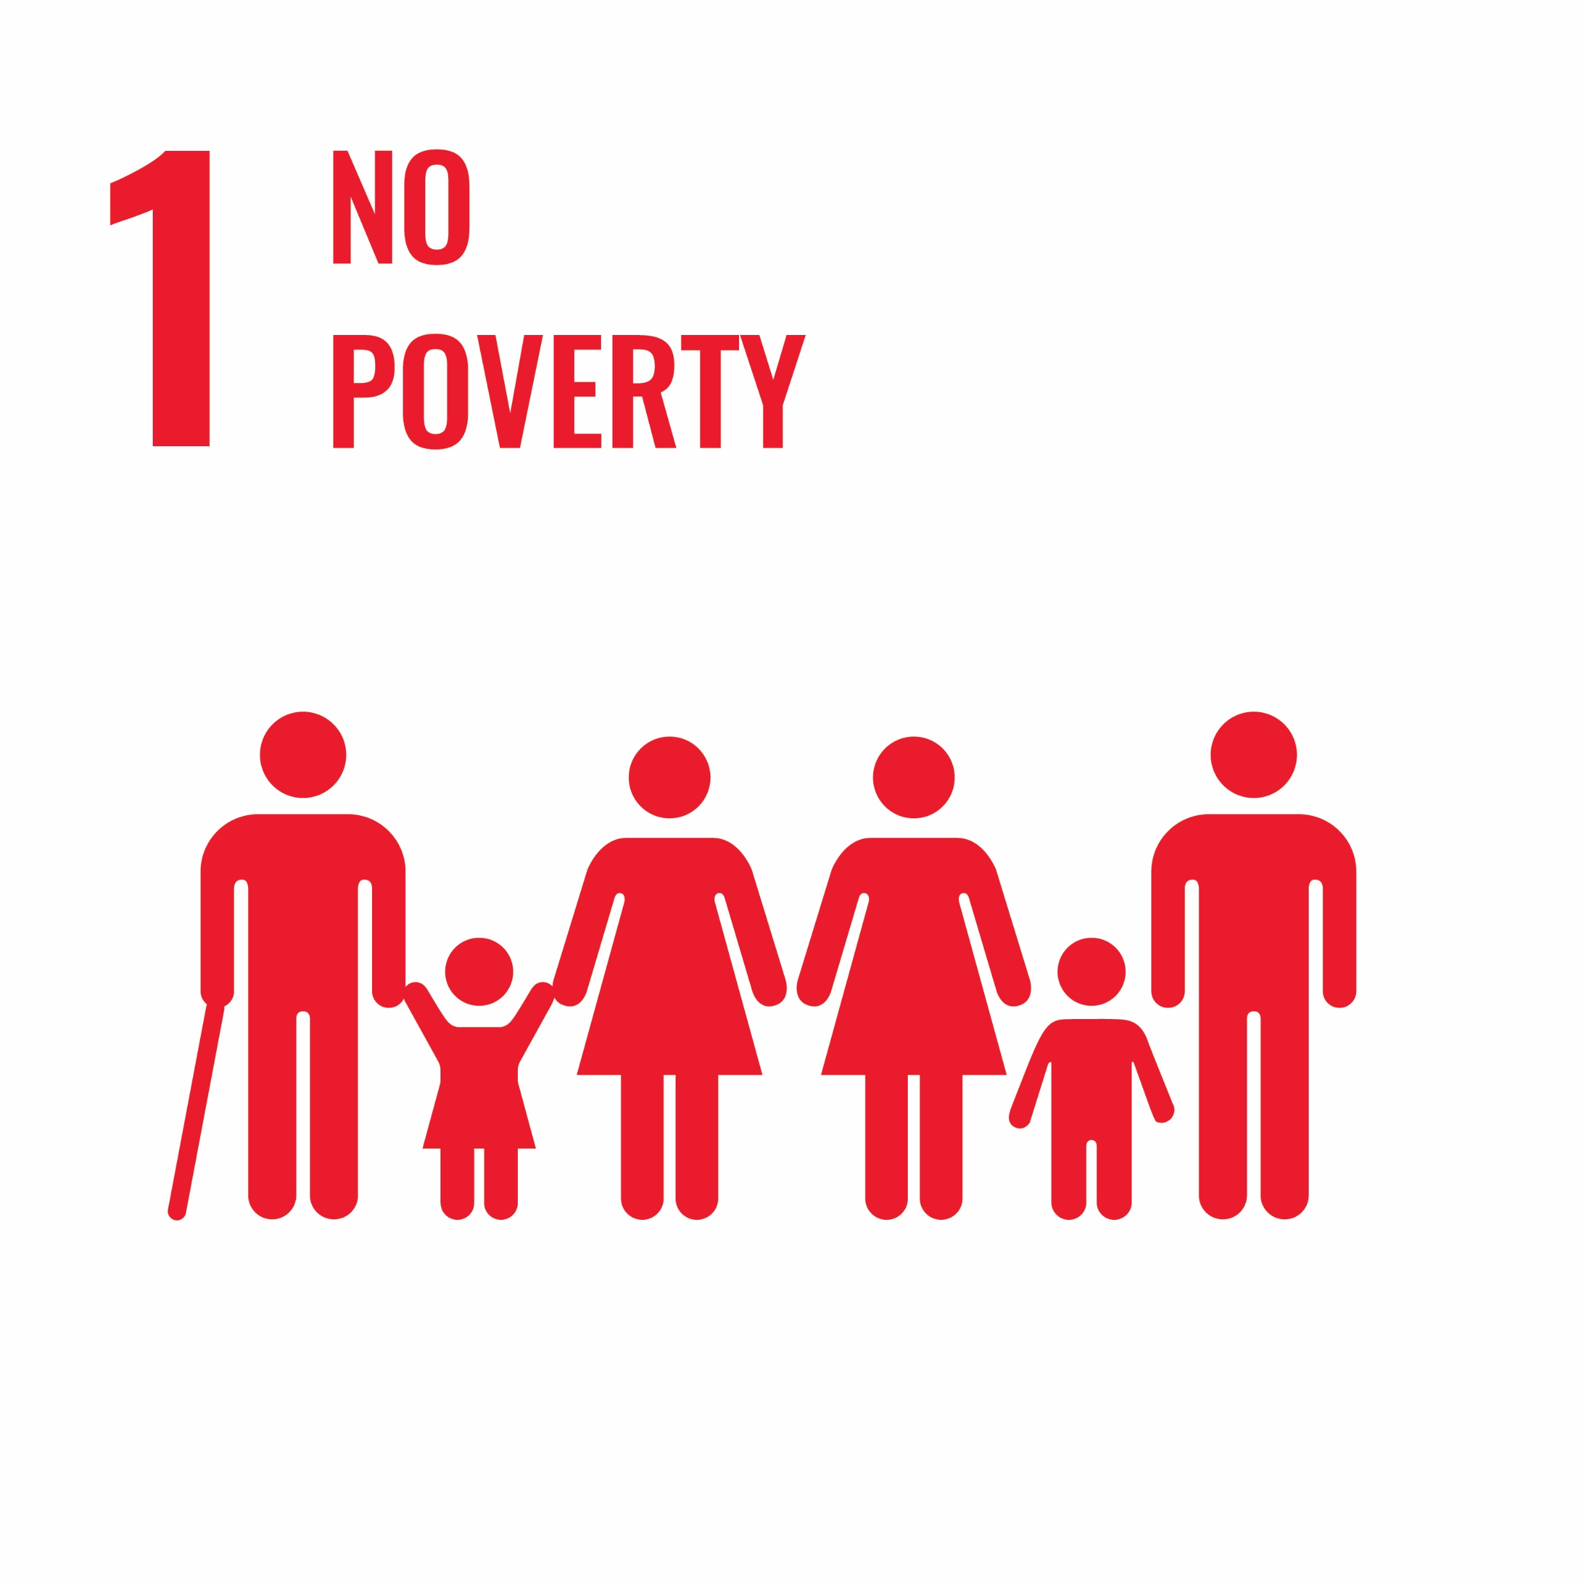
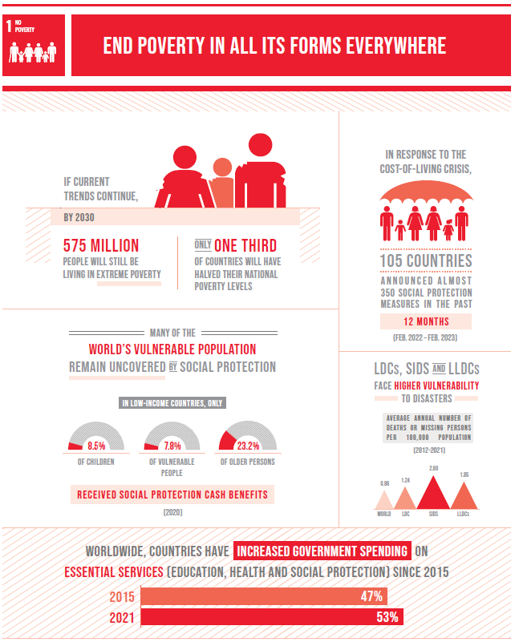
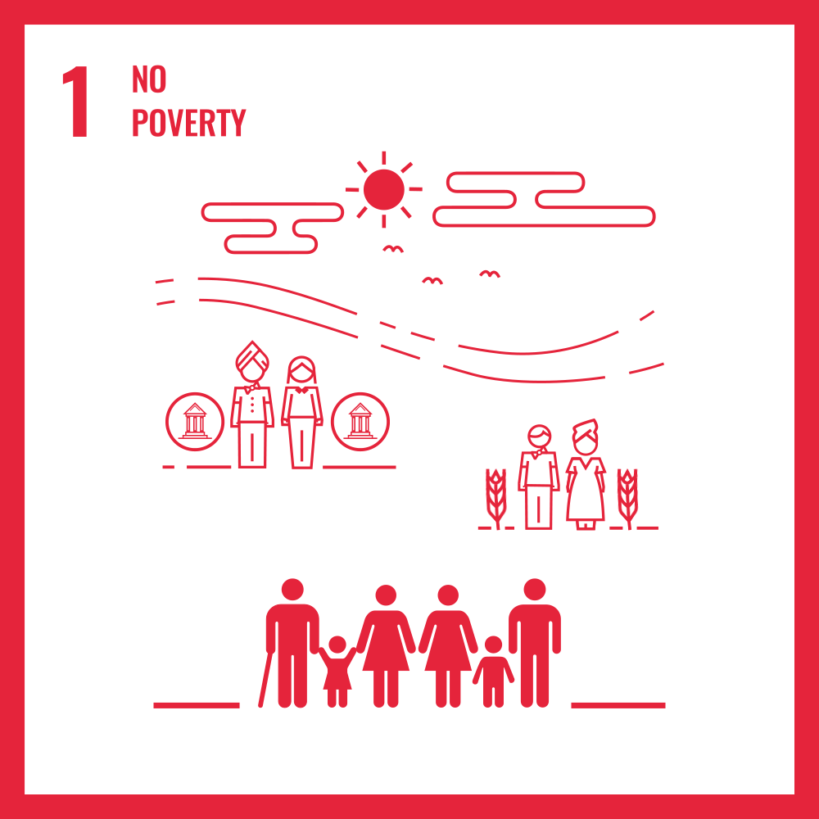

Slide 7
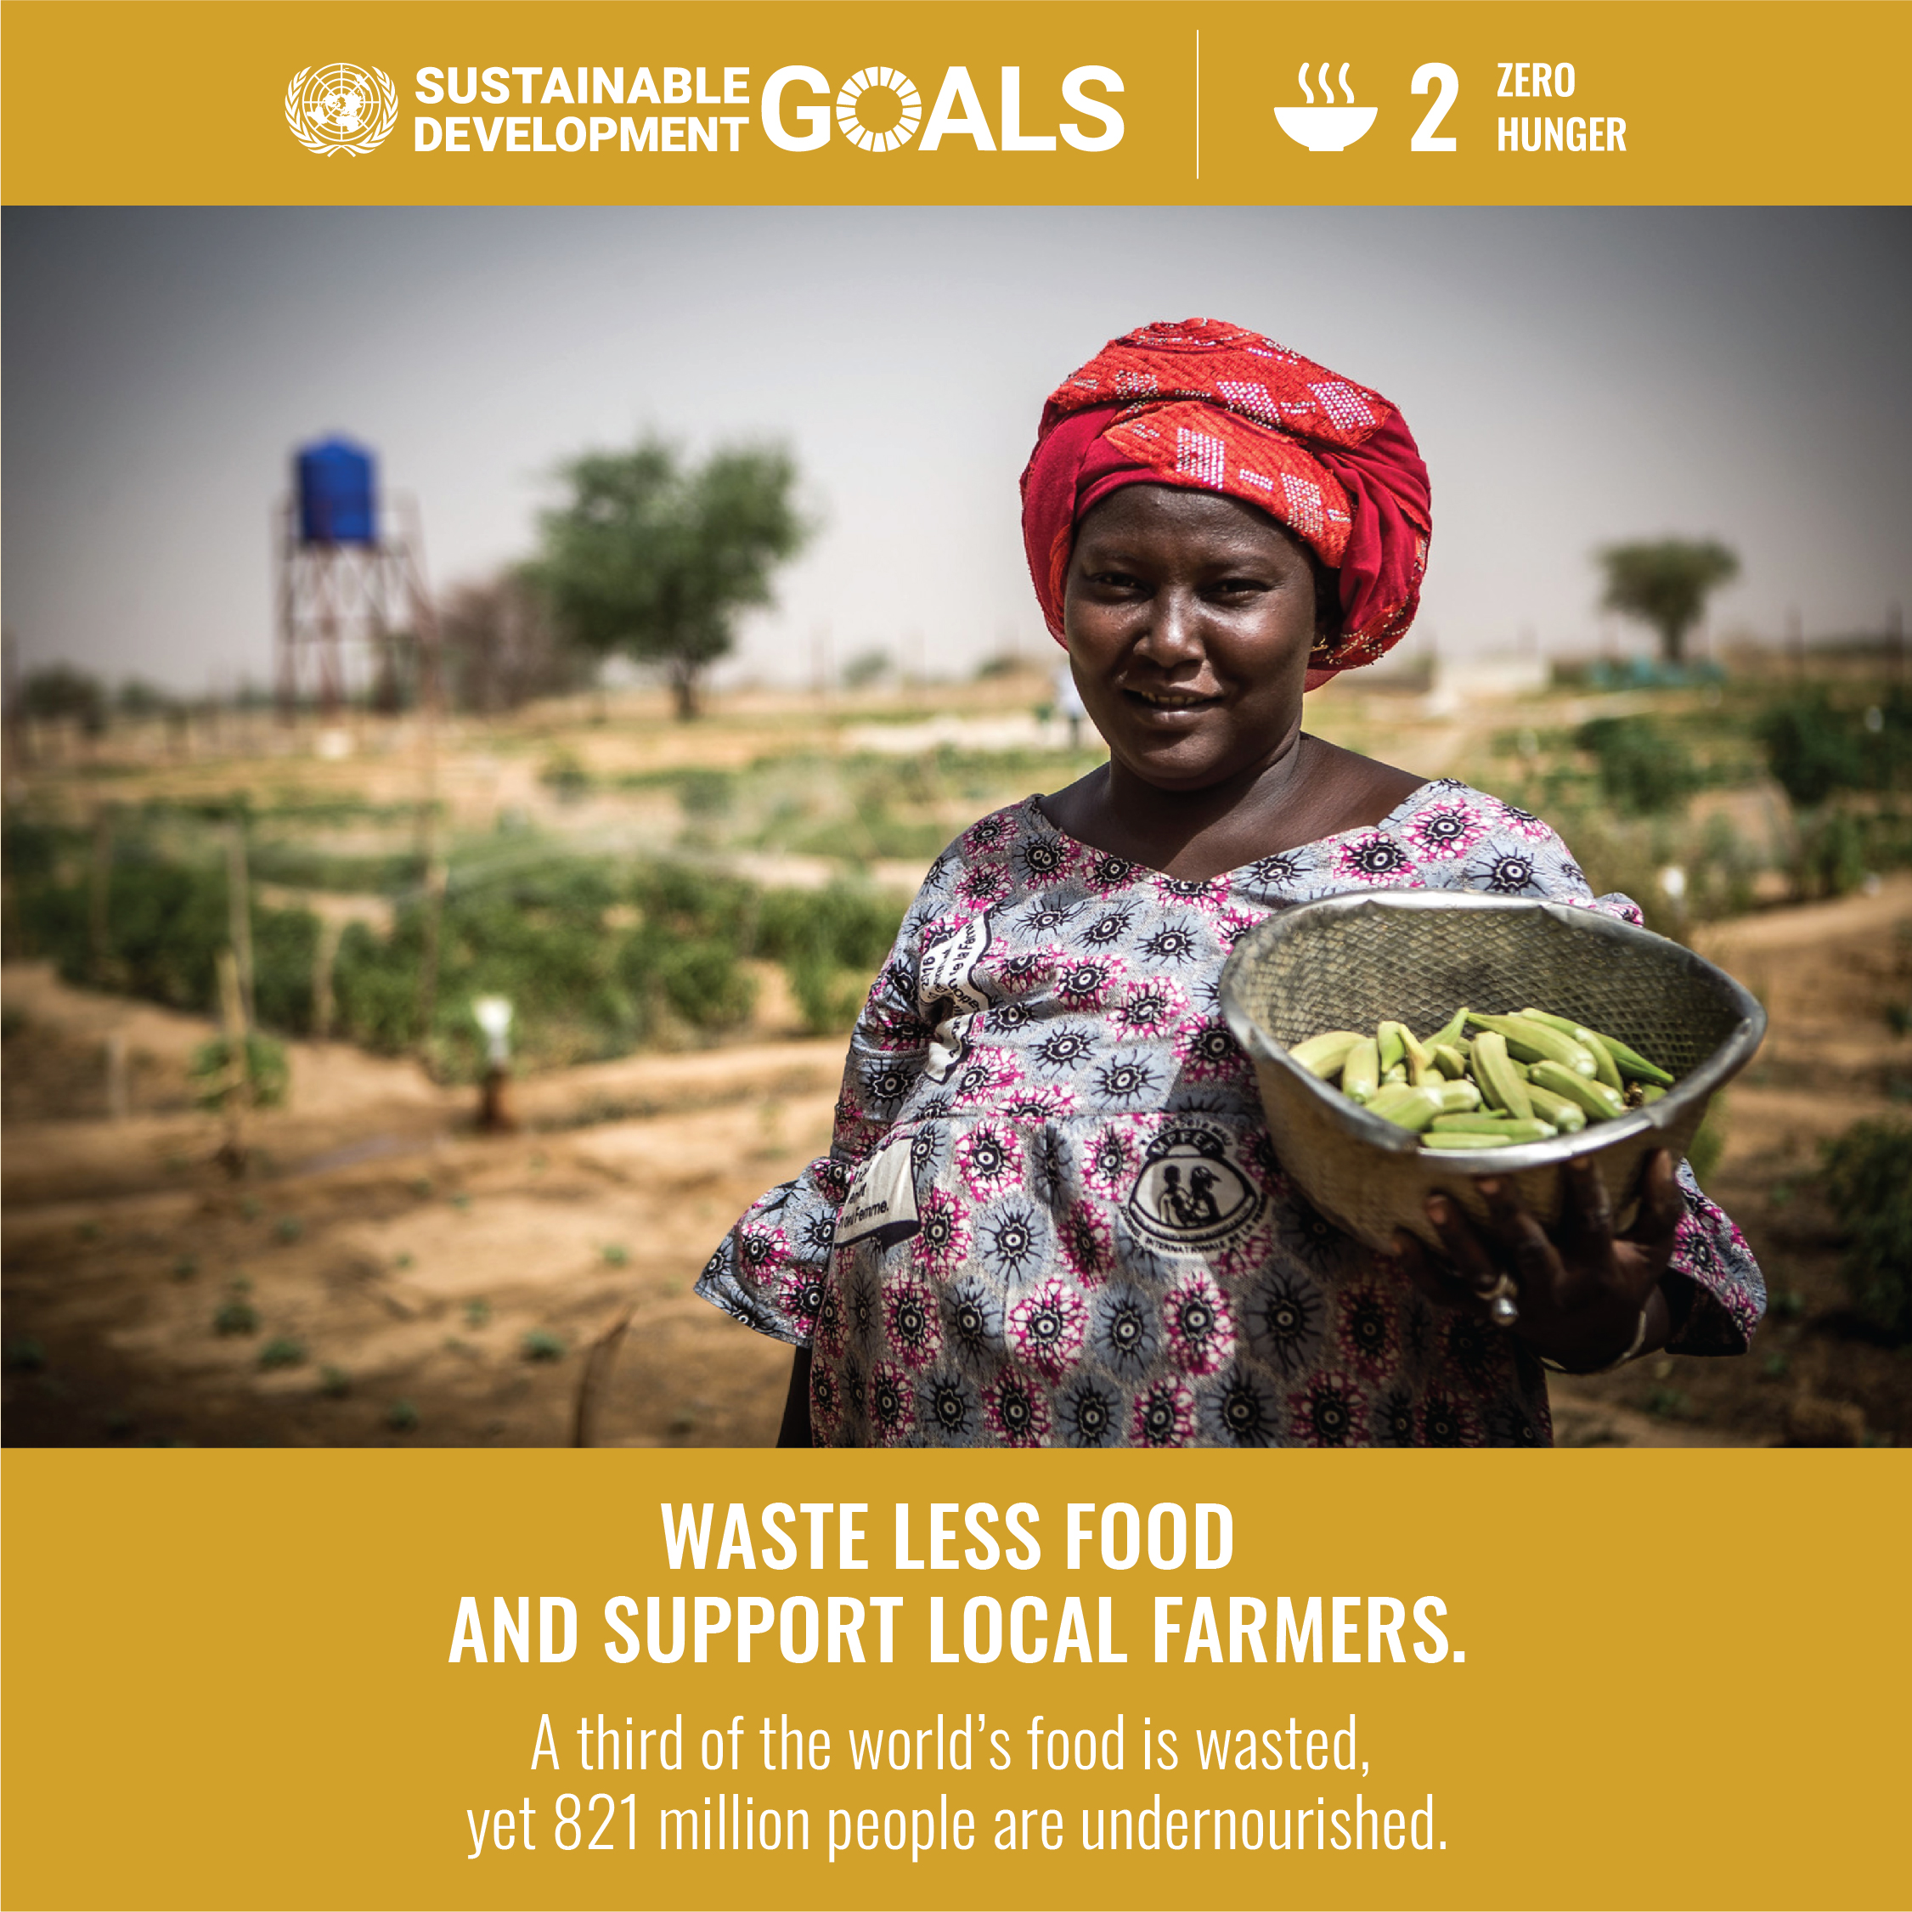
Goal 2 | Zero Hunger
Goal 2 of the 2030 Agenda for Sustainable Development aims to eliminate hunger and ensure food security globally by 2030. However, hunger and food insecurity have been increasing since 2015 due to factors such as the COVID-19 pandemic, conflicts, climate change, and inequality.
By 2022:
735 million people (9.2% of the global population) were frequently hungry—a sharp rise from 2019.
2.4 billion people faced moderate to simple food insecurity, 391 million more than in 2019.
148 million children suffered from underdeveloped growth, and 45 million children under 5 were affected by wasting.
Hunger traps individuals in a cycle of low productivity, poor health, and limited economic opportunities, hindering sustainable development. This crisis requires urgent, coordinated global action to address the root causes and improve suffering.

Slide 8
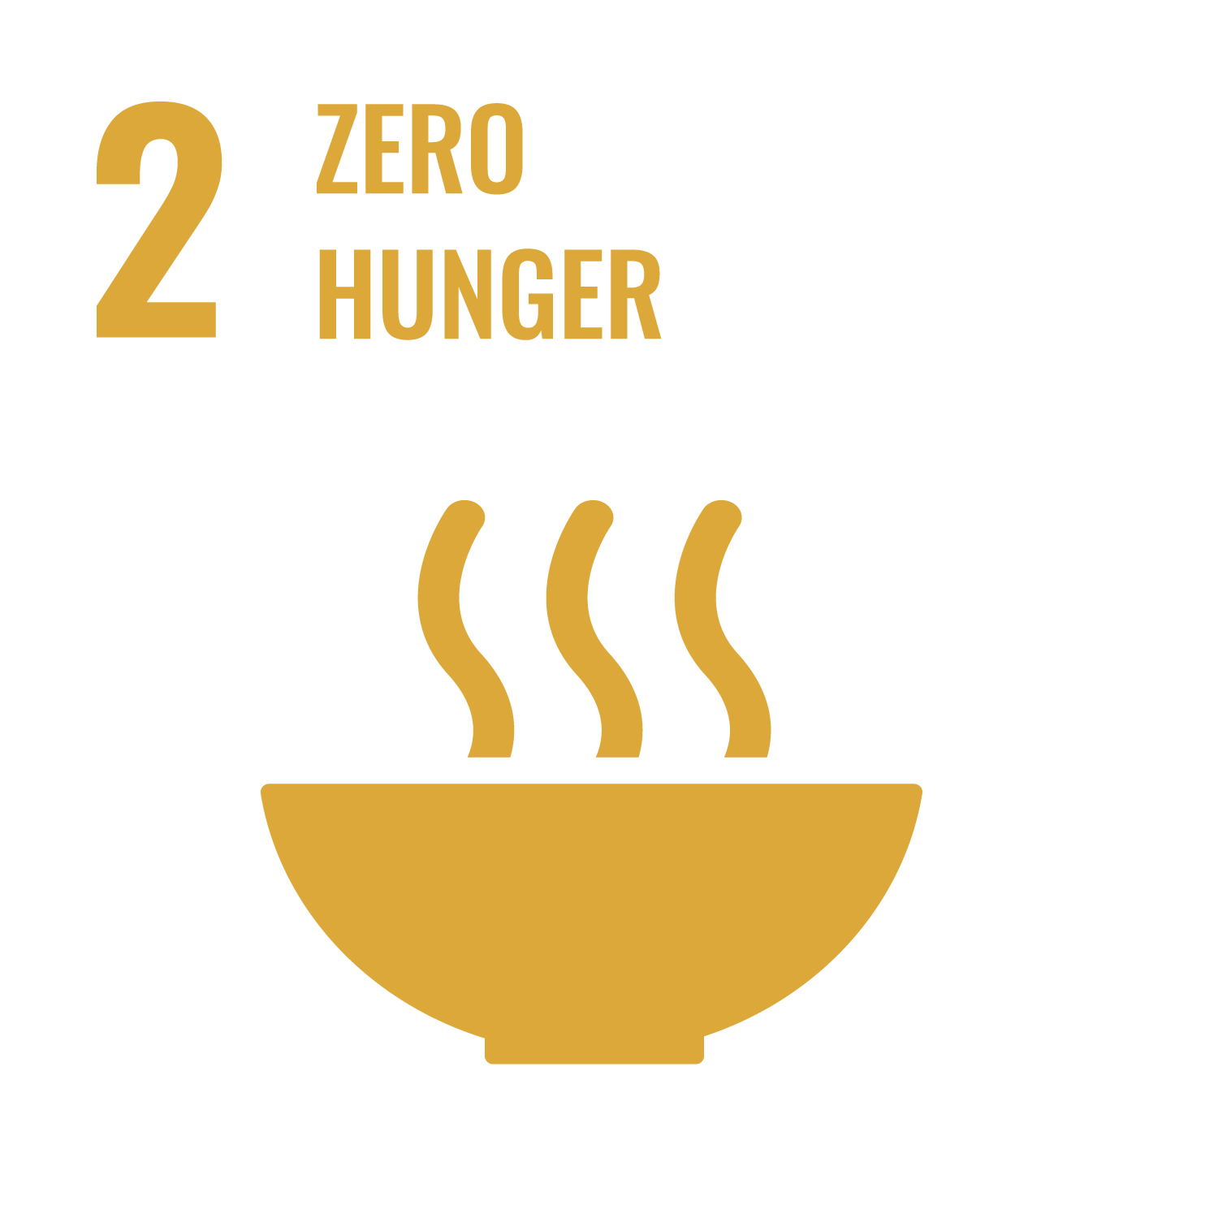
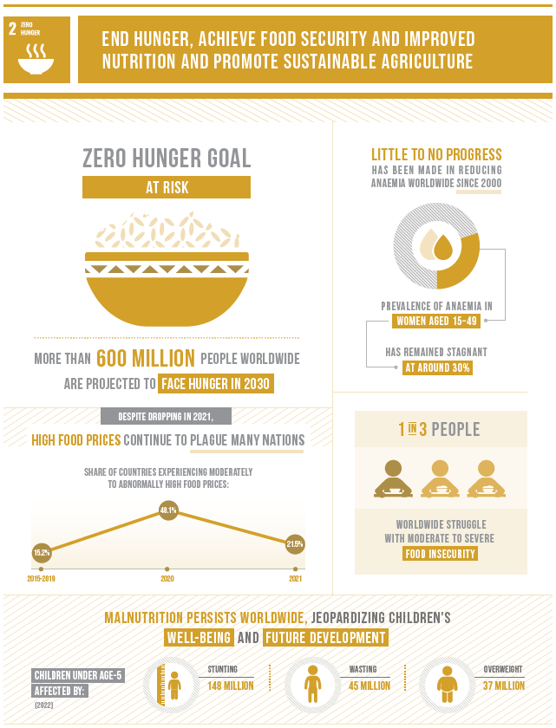
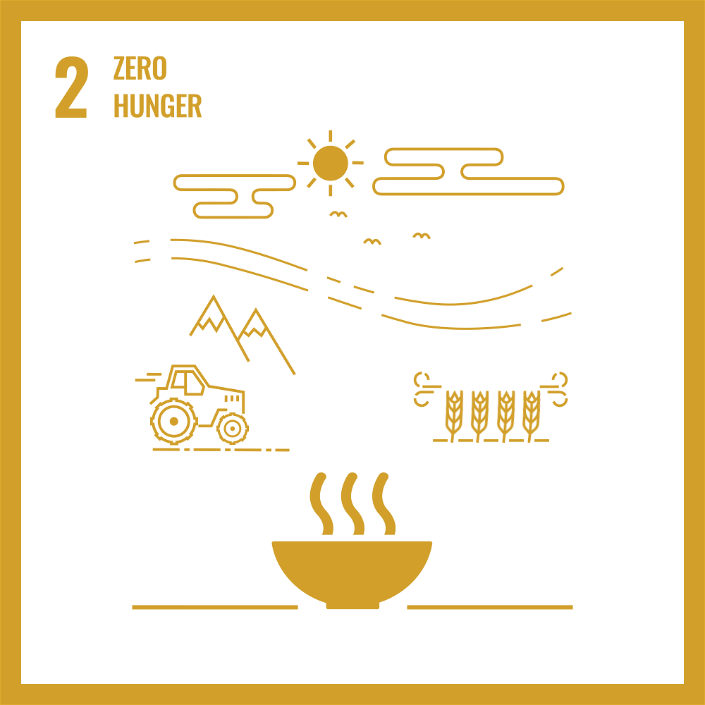

Slide 9
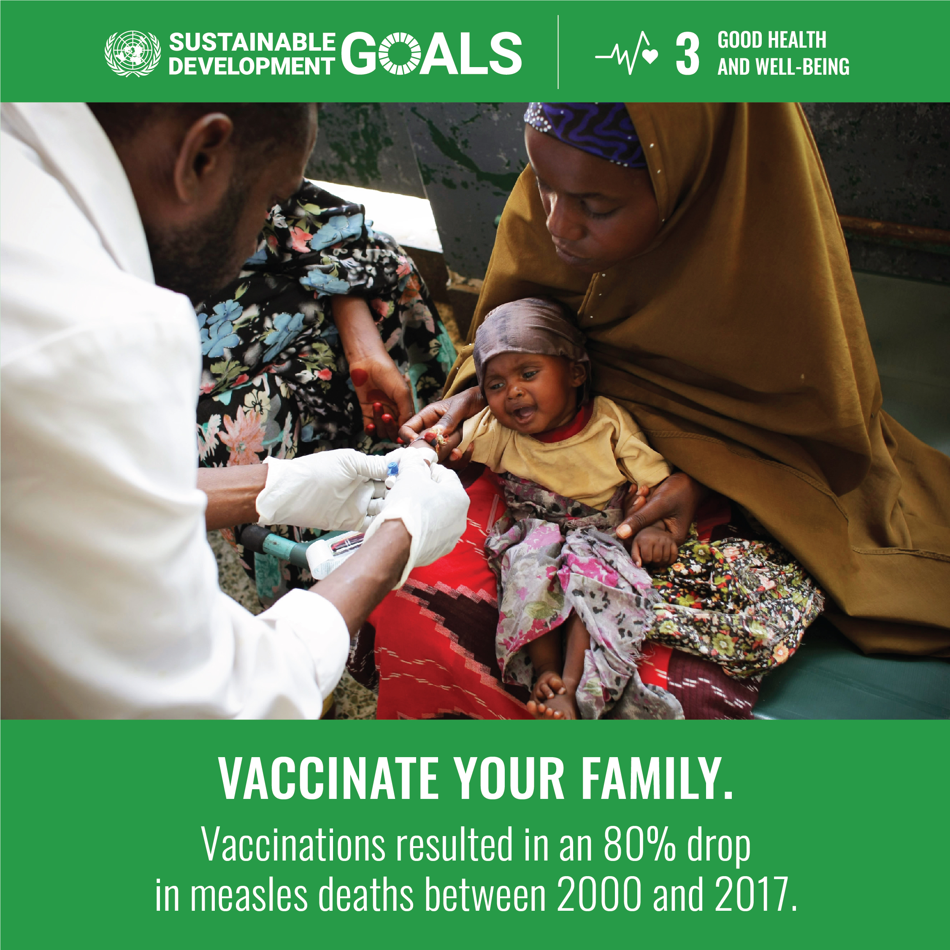
Goal 3 | Good Health and Well-Being
Significant progress has been made toward improving global health, with 146 out of 200 countries on track to meet the SDG target for under-5 mortality, a 52% reduction in AIDS-related deaths since 2010, and the elimination of at least one neglected tropical disease in 47 countries.
However, inequalities in health care and the impacts of the COVID-19 pandemic have reversed some gains. Childhood vaccinations have seen a historic decline, and deaths from tuberculosis and malaria have increased.
Goal 3 of the Sustainable Development Goals seeks to end waves of AIDS, tuberculosis, malaria, and other diseases by 2030 while achieving universal health coverage and ensuring access to safe, affordable medicines and vaccines.
To achieve these goals, countries must increase investment in health systems, build resilience, and address health inequities to recover from current setbacks and prepare for future threats.

Slide 10
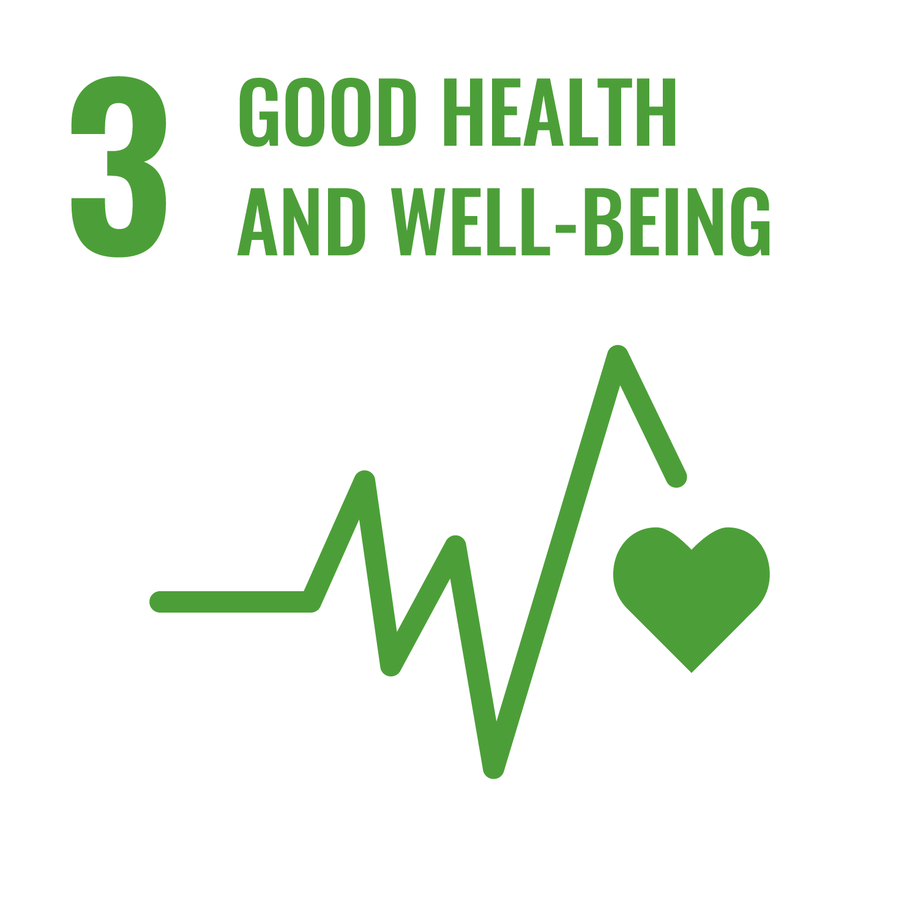
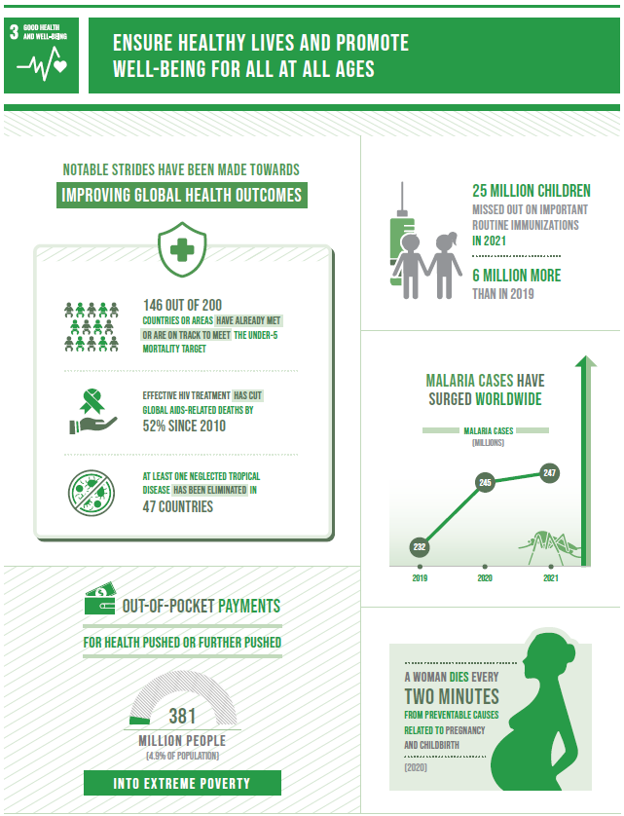
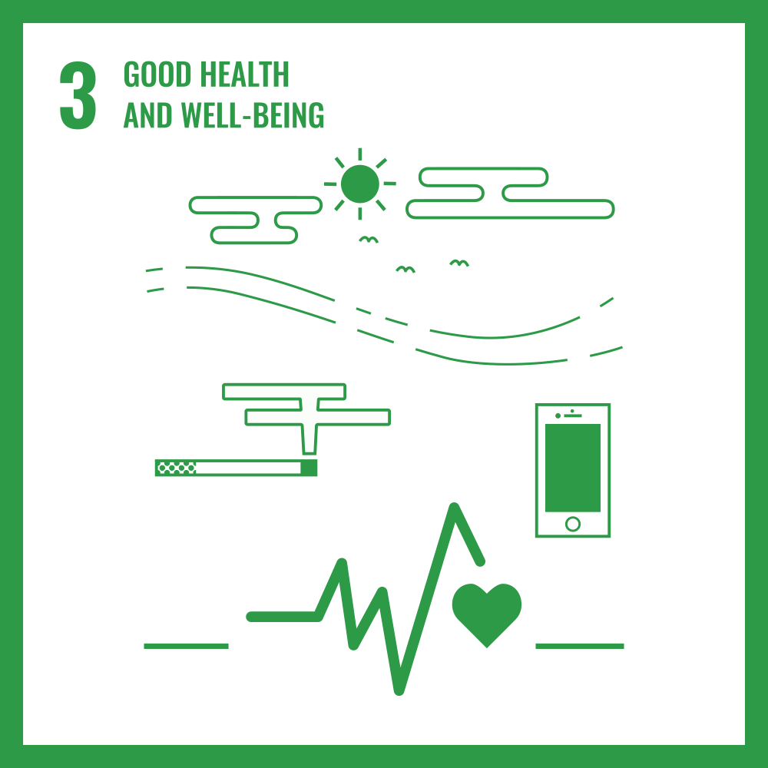

Slide 11
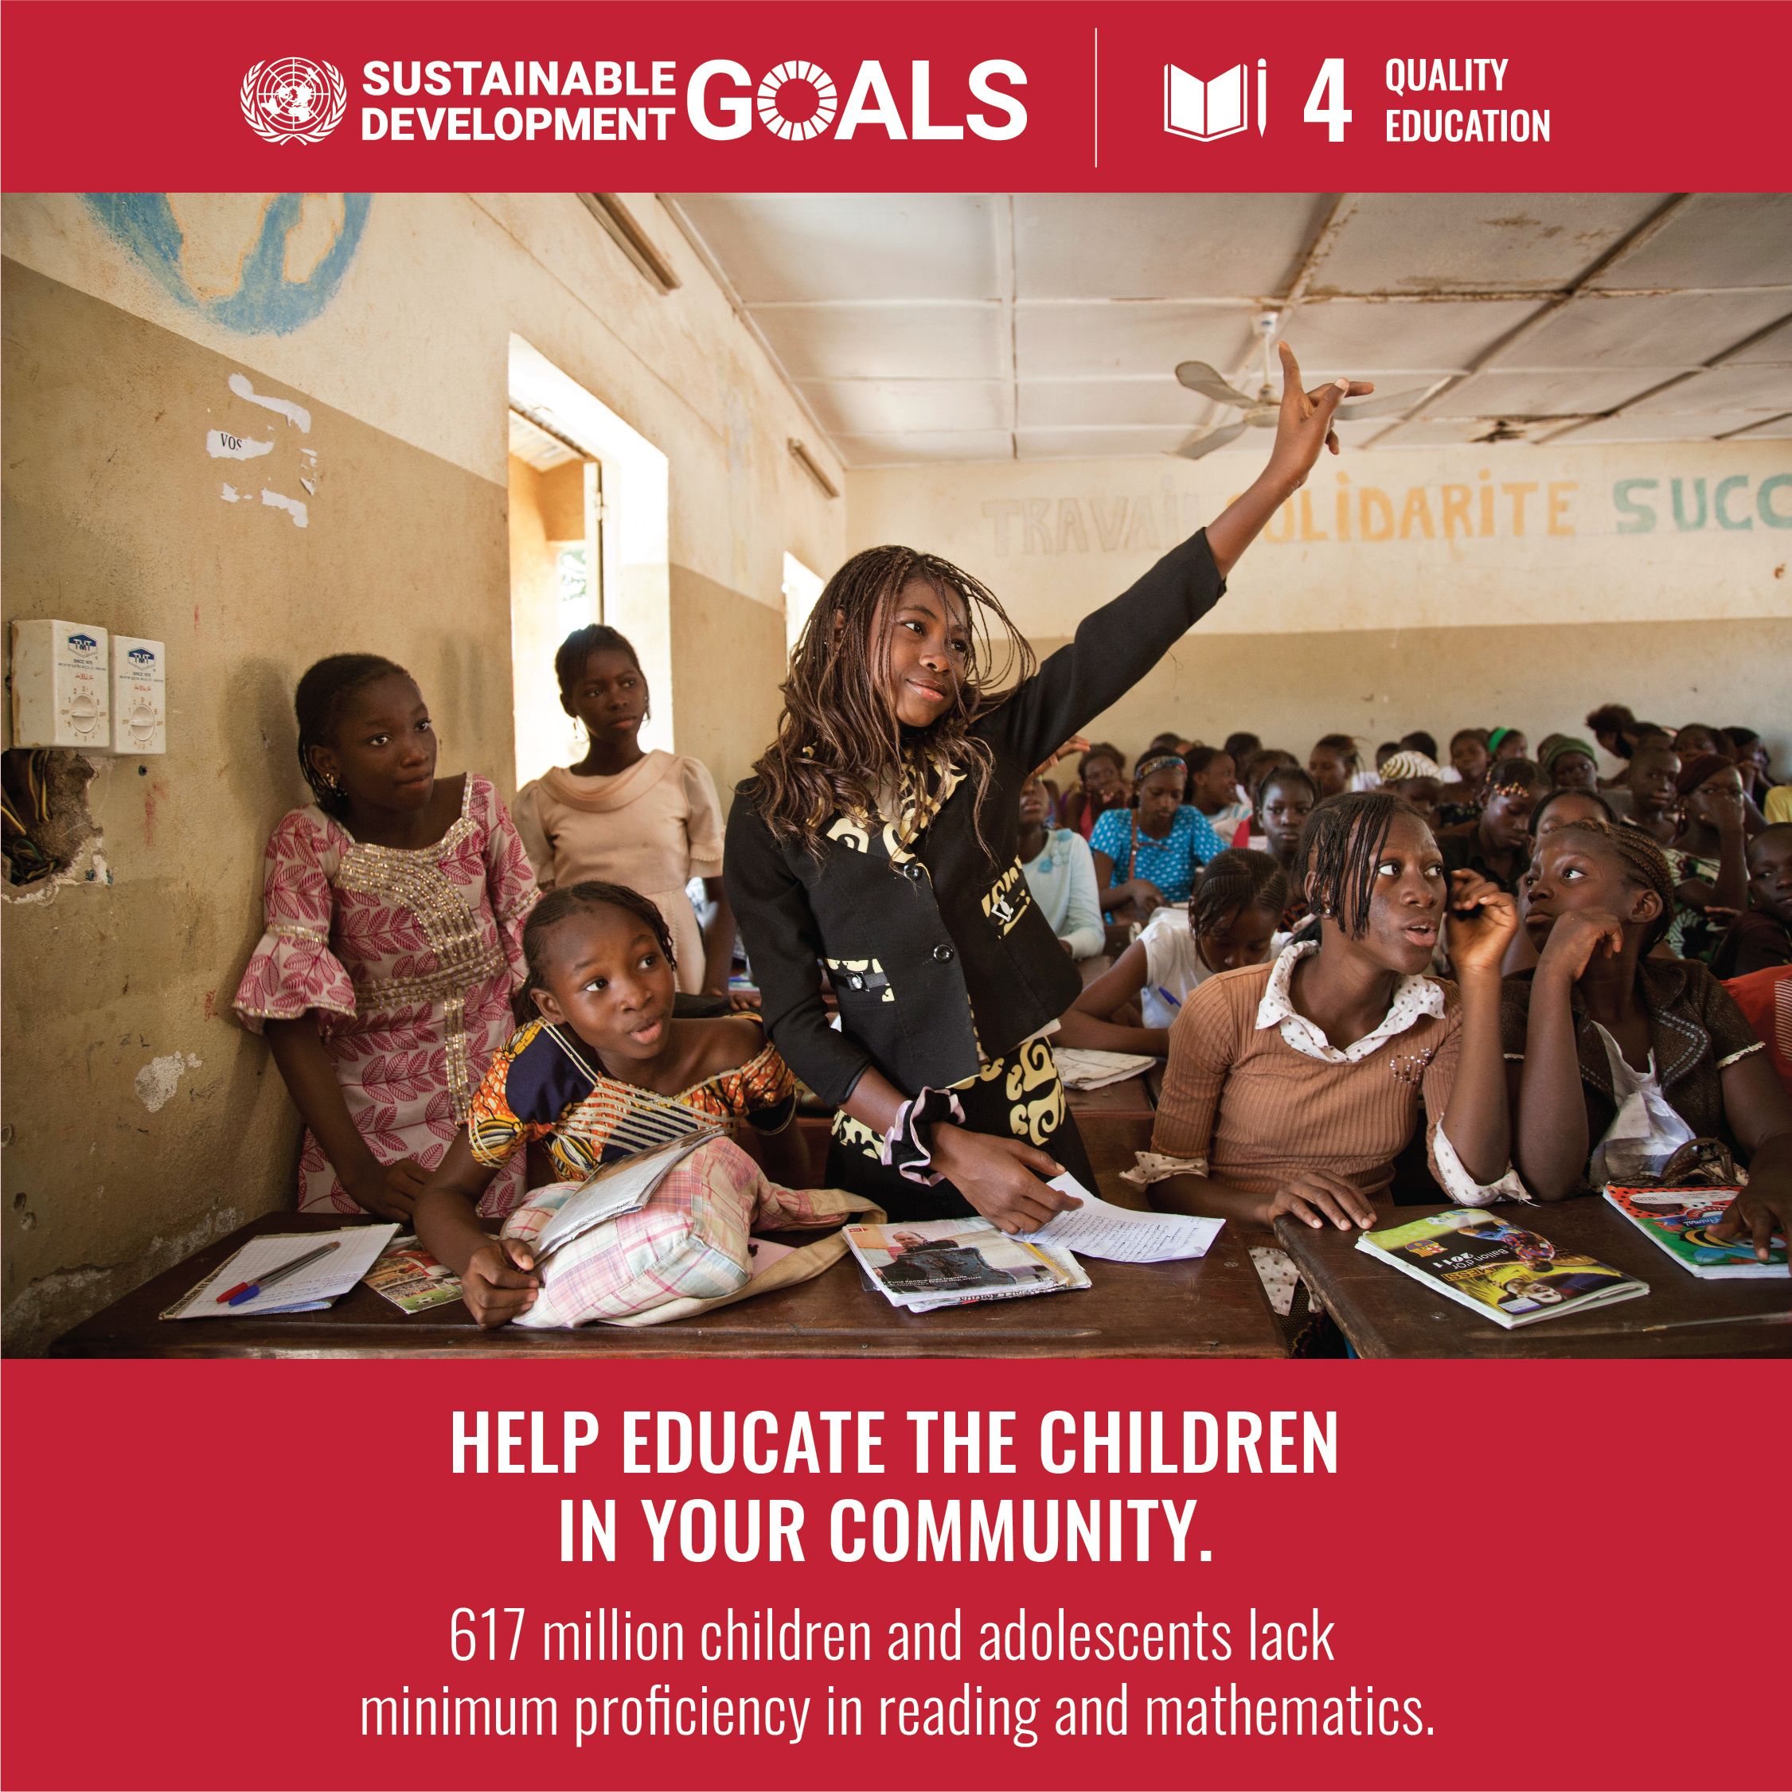
Goal 4 | Quality Education
The COVID-19 pandemic has exacerbated pre-existing challenges in education, leading to significant learning losses in many countries. By 2030, an estimated 84 million children and young people may remain out of school, and 300 million students could lack basic literacy and numeracy skills. Achieving universal access to quality education, including primary, secondary, vocational training, and higher education, is essential. Education is critical for advancing other Sustainable Development Goals (SDGs), such as reducing poverty, gender inequality, and fostering peaceful societies. To achieve these goals, increased investment in education, including making it free and compulsory, expanding the teacher workforce, improving infrastructure, and embracing digital tools, is needed.

Slide 12
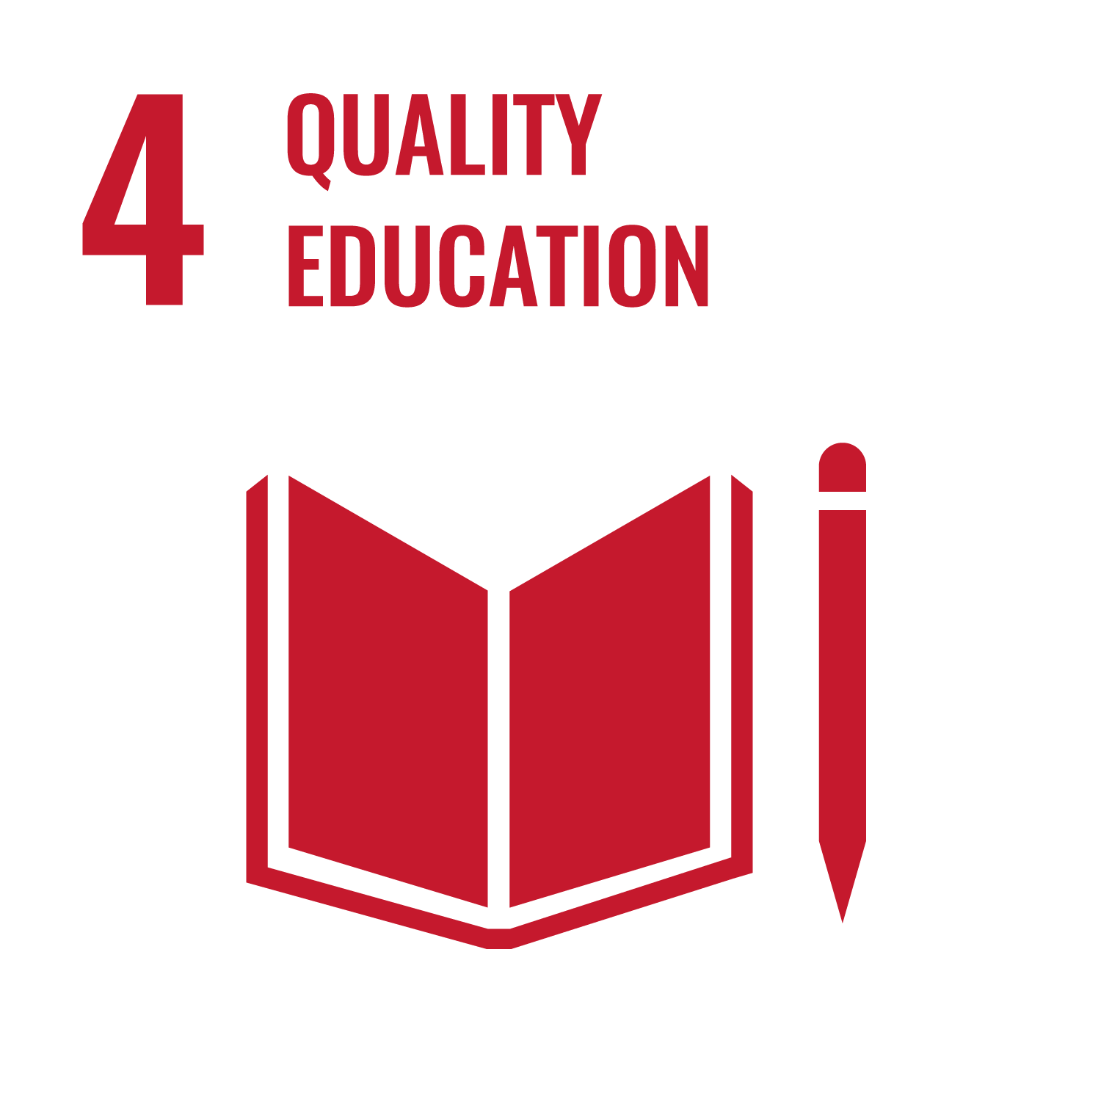
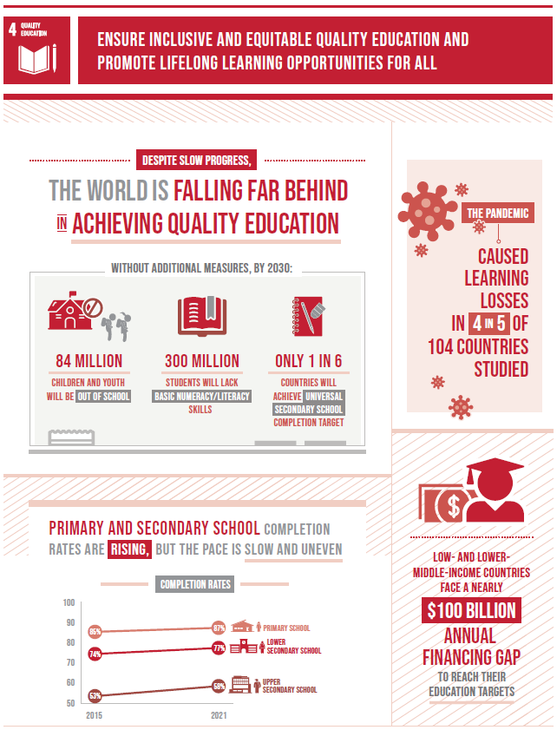
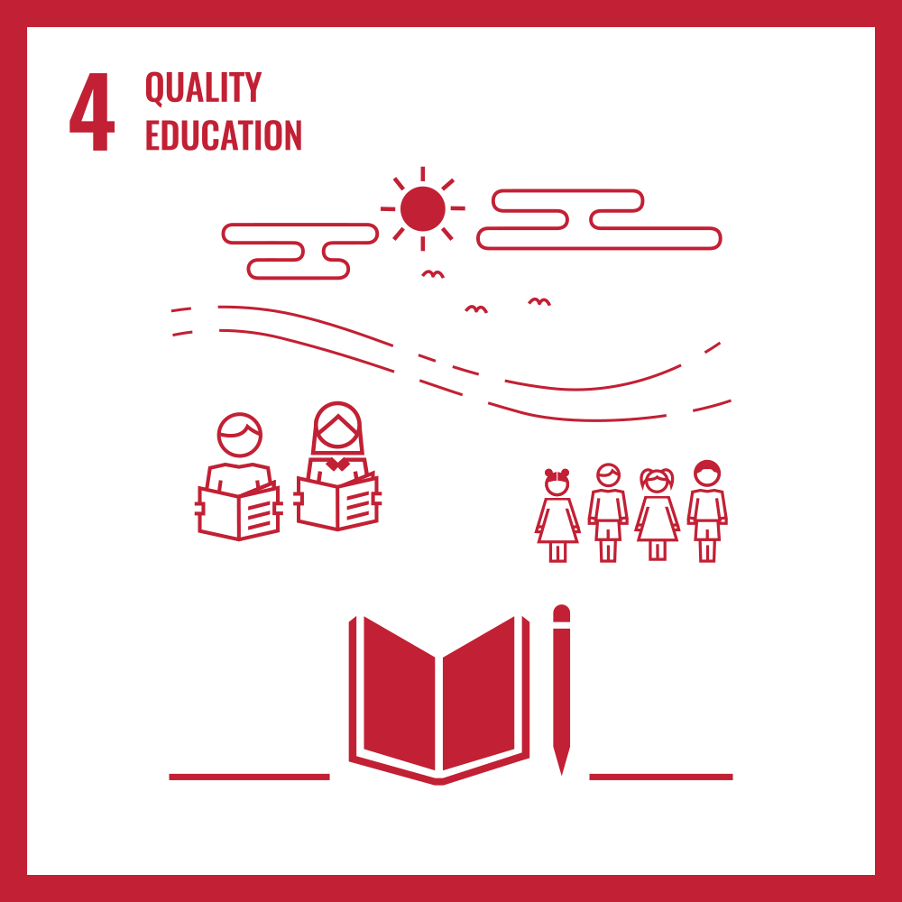

Slide 13
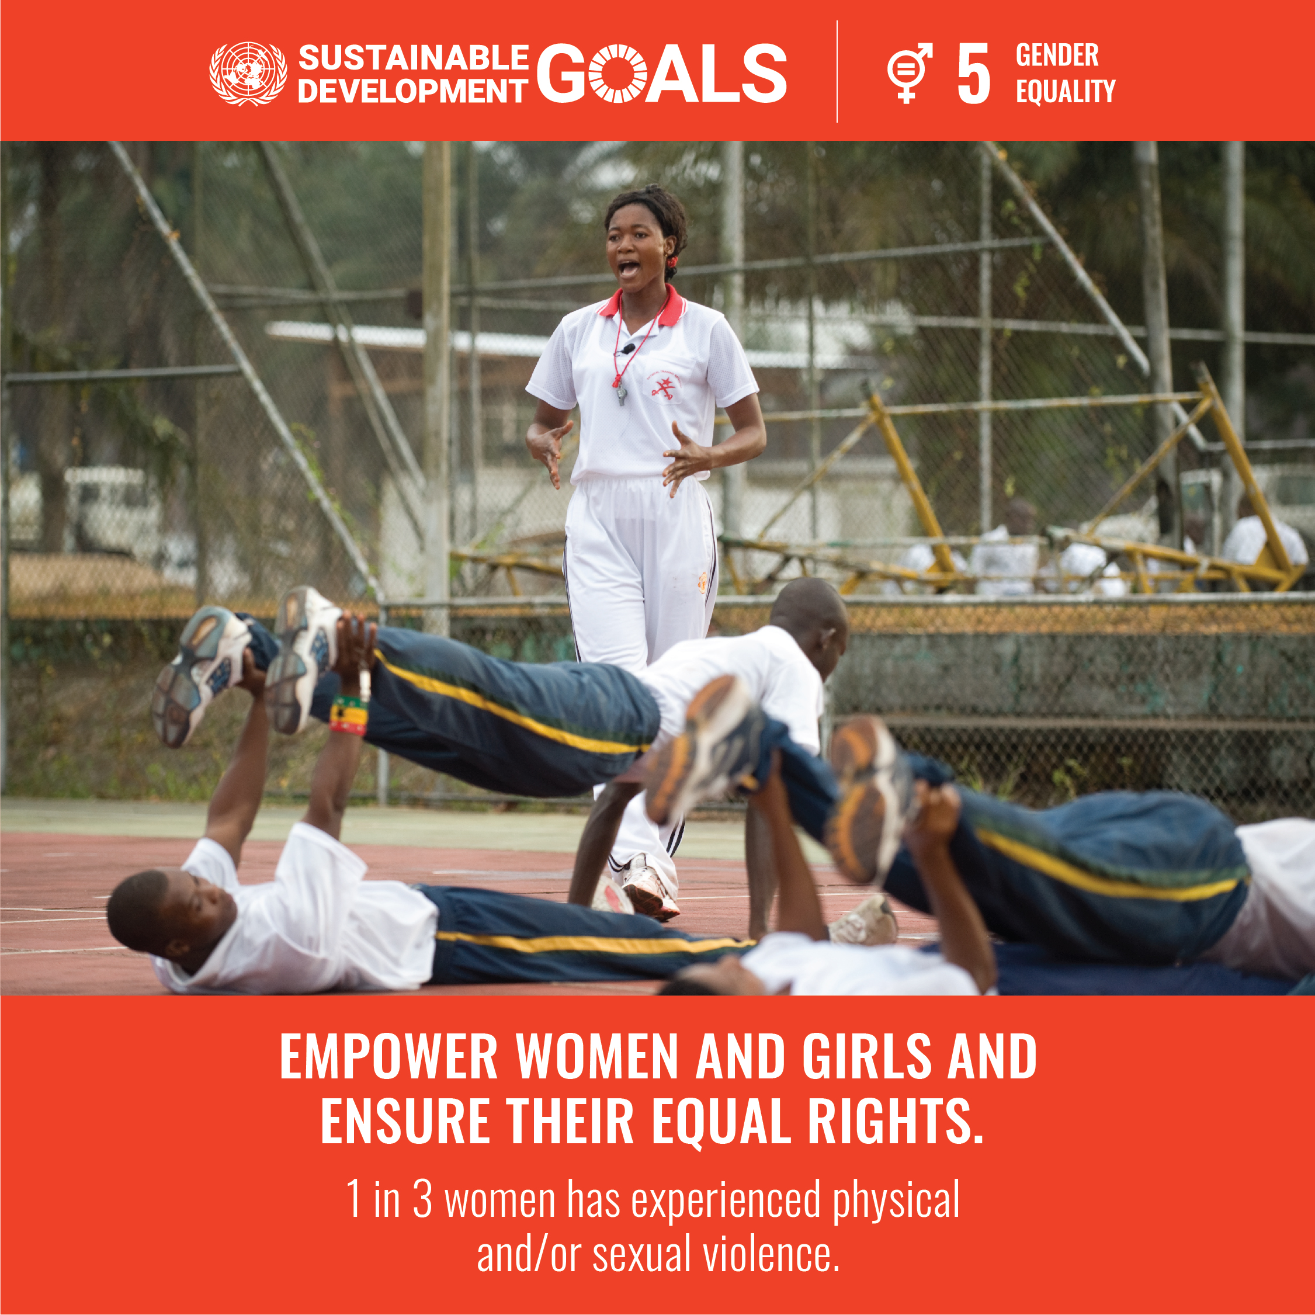
Goal 5 | Gender Equality
Gender equality is a fundamental human right and a cornerstone for a peaceful, prosperous, and sustainable world. While progress has been made, the world is not on track to achieve gender equality by 2030.
Women and girls represent half of the world’s population and potential, yet gender inequality persists. On average, women earn 23% less than men and spend three times as many hours in unpaid care work.
Sexual violence, unpaid care work, and discrimination in leadership positions remain major barriers, worsened by the COVID-19 pandemic. Women are also disproportionately affected by increased care responsibilities and health care roles.
At the current rate, it will take 300 years to end child marriage, 286 years to remove discriminatory laws, 140 years for equal representation in leadership, and 47 years for gender equality in national parliaments.
Political leadership, investments, and policy reforms are essential to achieving Goal 5—gender equality must be prioritized in national policies, budgets, and institutions.

Slide 14
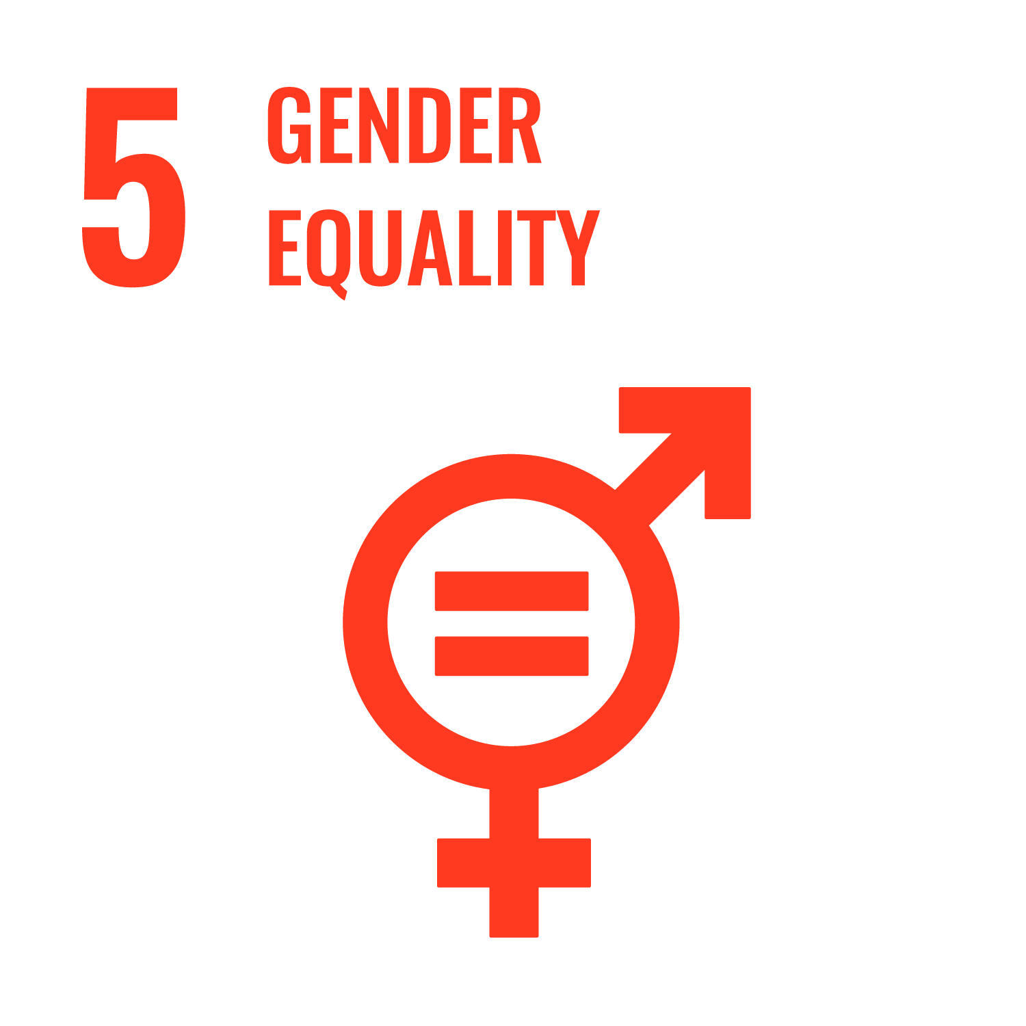
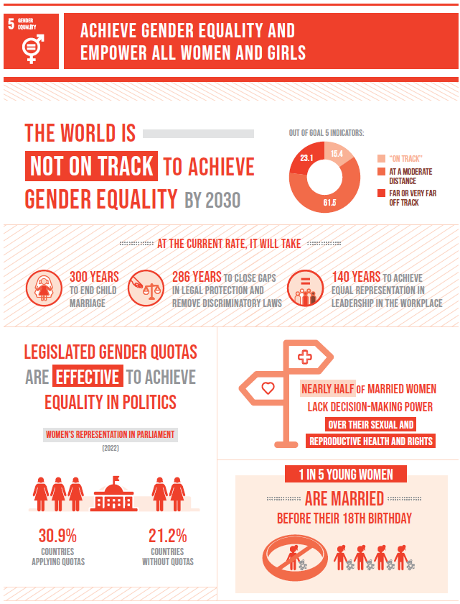
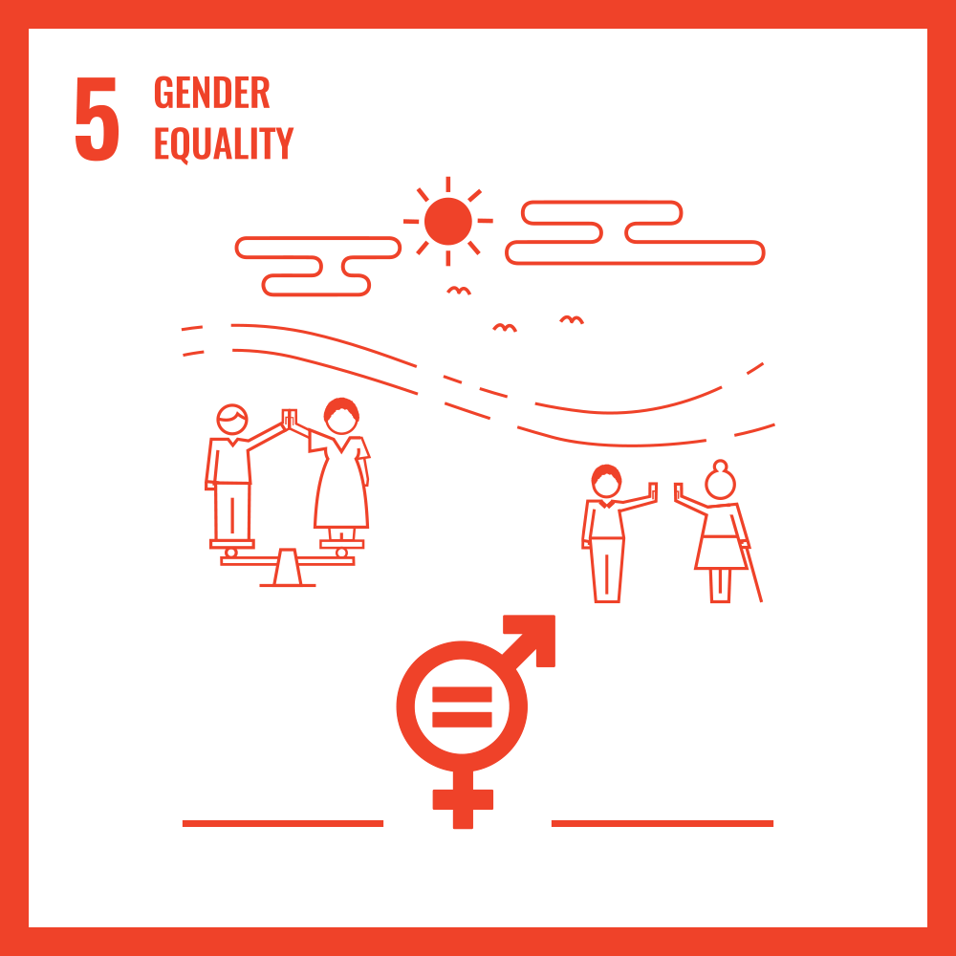

Slide 15
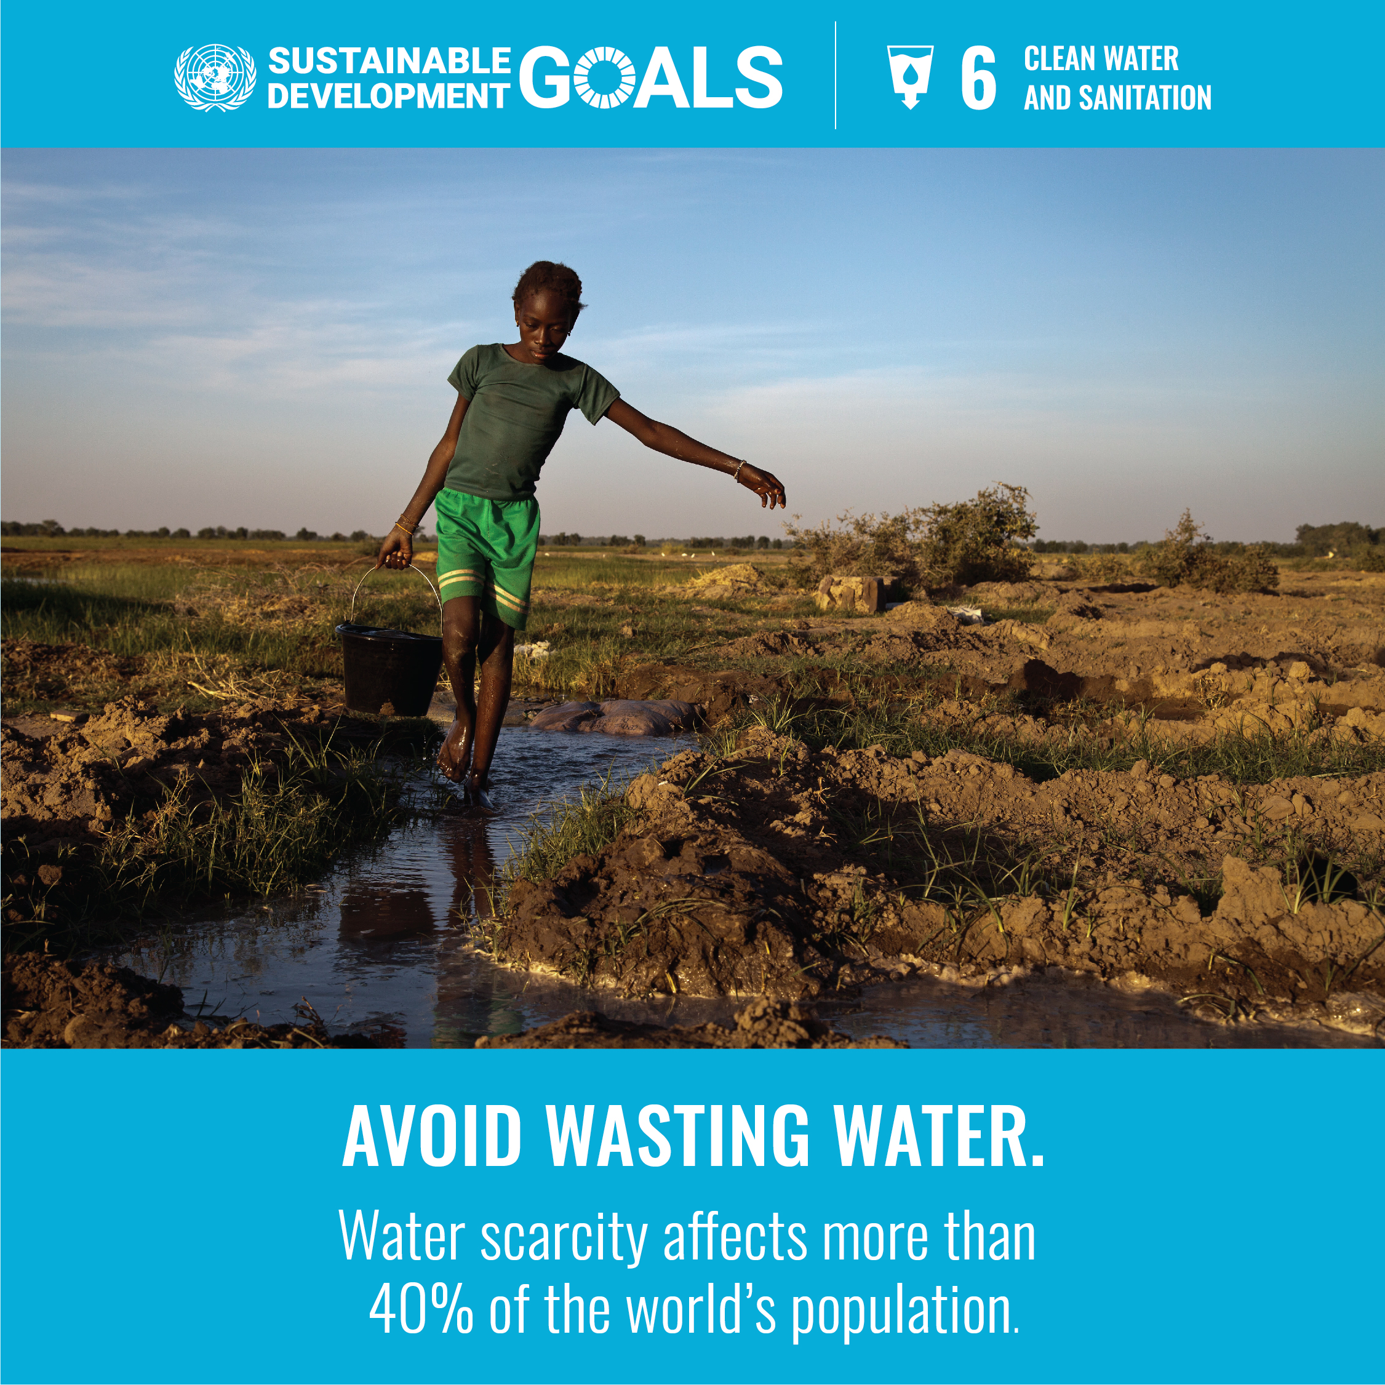
Goal 6 | Clean Water and Sanitation
Access to safe water, sanitation, and hygiene is essential for health and well-being. Without significant progress, billions will lack these basic services by 2030. The demand for water is rising due to population growth, urbanization, and increasing needs from agriculture, industry, and energy sectors.
Half of the world’s population already faces severe water scarcity for at least one month a year, and this is projected to worsen with climate change.
To ensure universal access to safe drinking water by 2030, investments in infrastructure, sanitation, ecosystem restoration, and hygiene education are crucial. Improving water-use efficiency is key to reducing water stress.
There has been positive progress: between 2015 and 2022, access to safely managed drinking water increased from 69% to 73% globally.

Slide 16
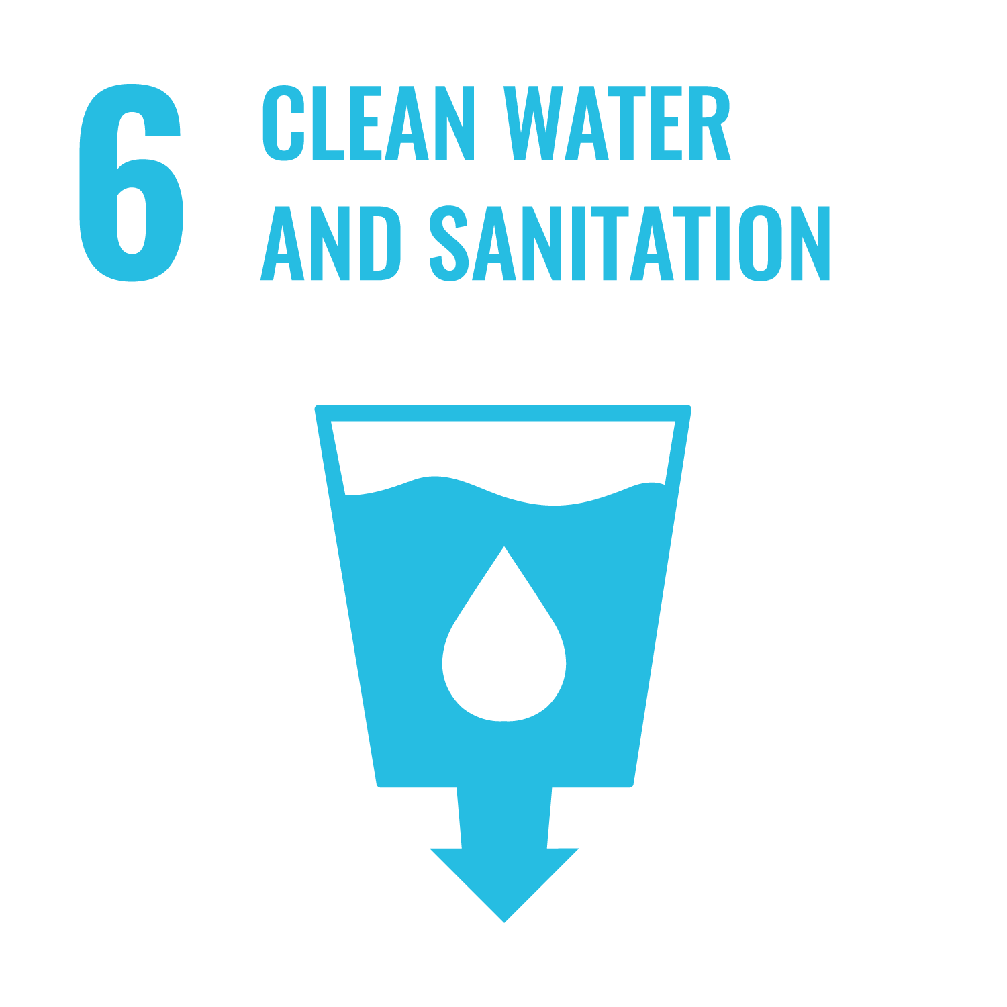
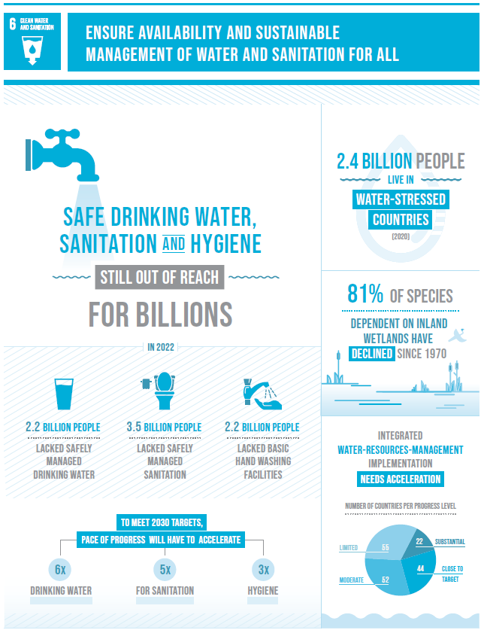
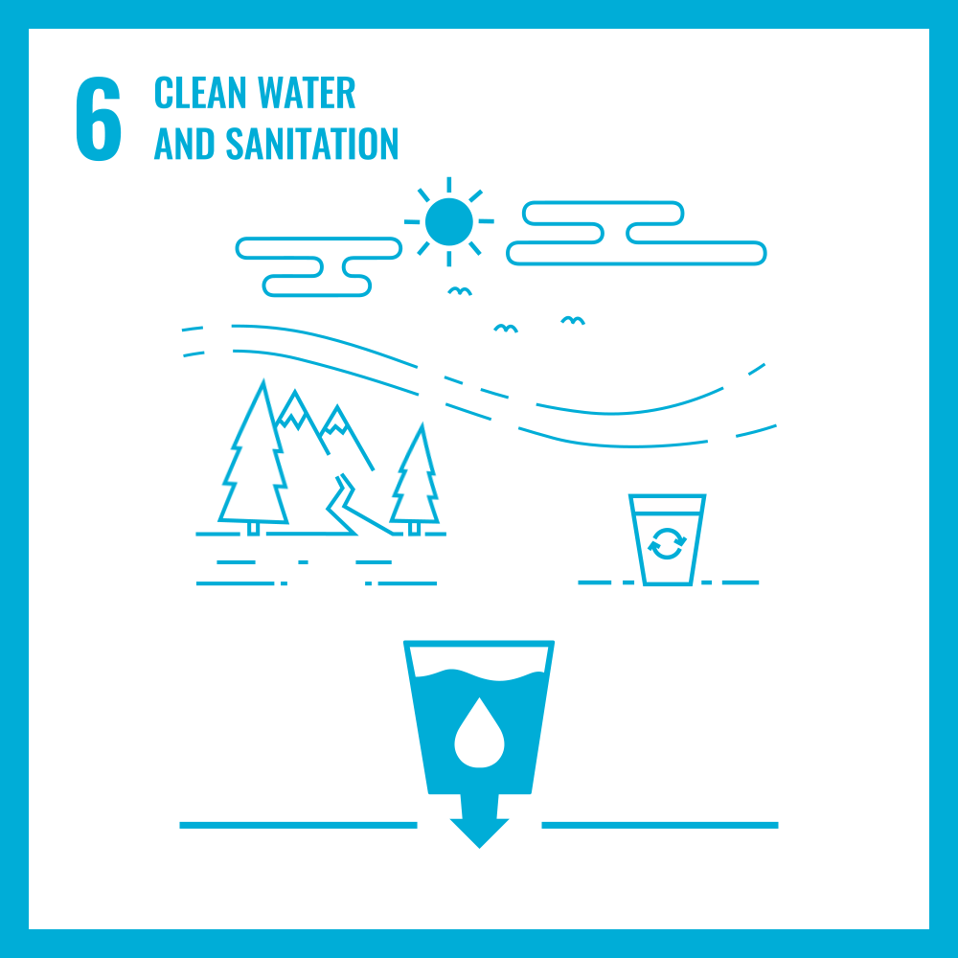

Slide 17
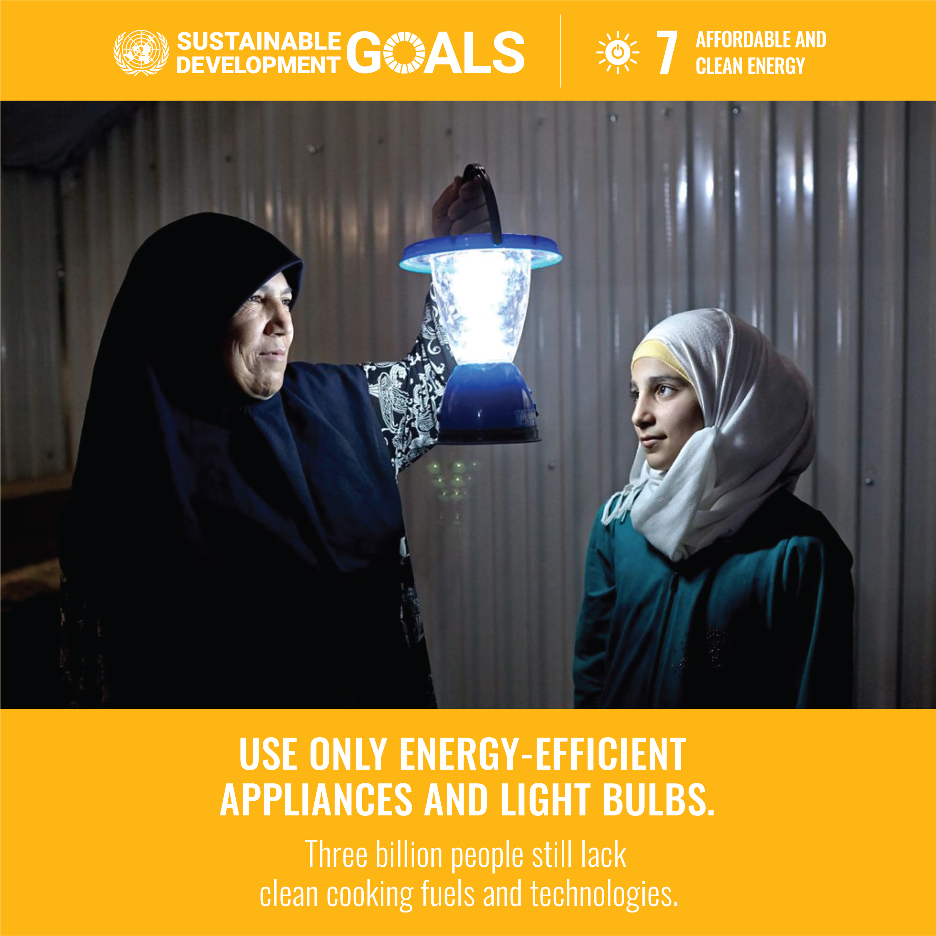
Goal 7 | Affordable and Clean Energy
Goal 7 focuses on ensuring access to clean and affordable energy, crucial for sectors like agriculture, business, education, healthcare, and transportation.
While progress is being made, it is not fast enough. By 2030, about 660 million people will still lack access to electricity, and nearly 2 billion people will rely on polluting fuels for cooking.
Energy consumption is the leading cause of climate change, accounting for about 60% of global greenhouse gas emissions.
From 2015 to 2021, global access to electricity increased from 87% to 91%. Achieving universal access to affordable electricity by 2030 requires investments in clean energy sources like solar, wind, and thermal. Expanding infrastructure and upgrading technology in developing countries is key to promoting both growth and environmental sustainability.

Slide 18
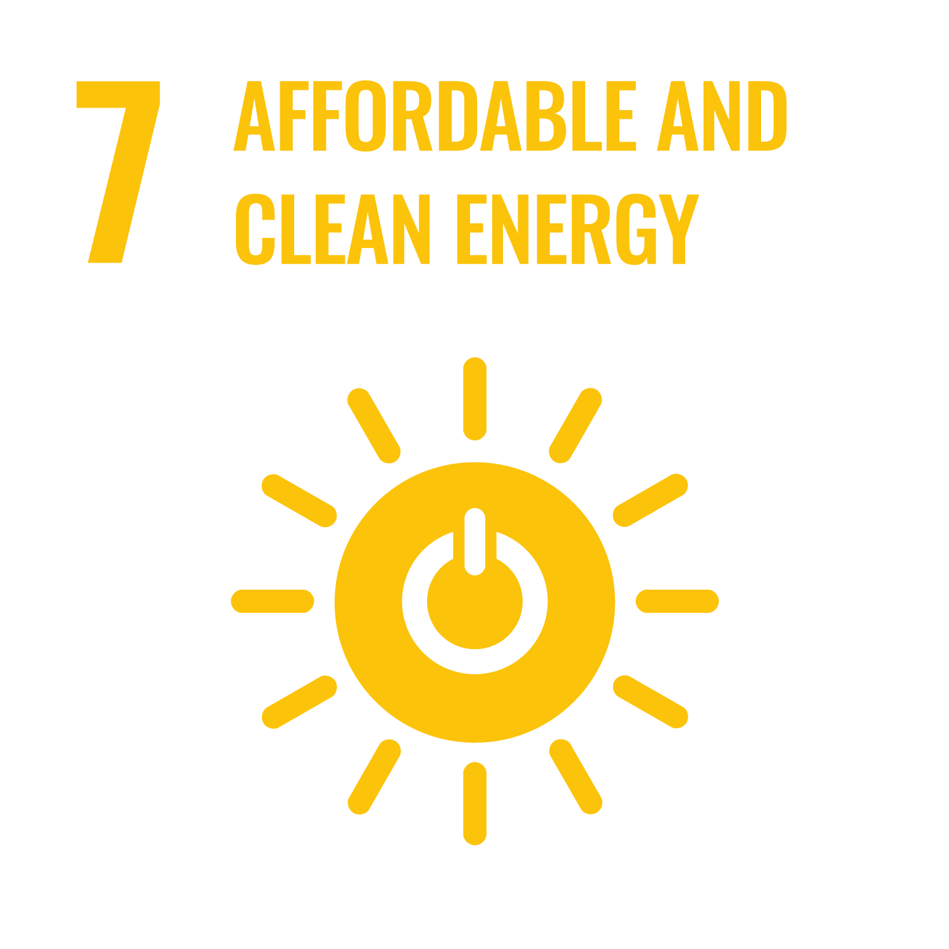
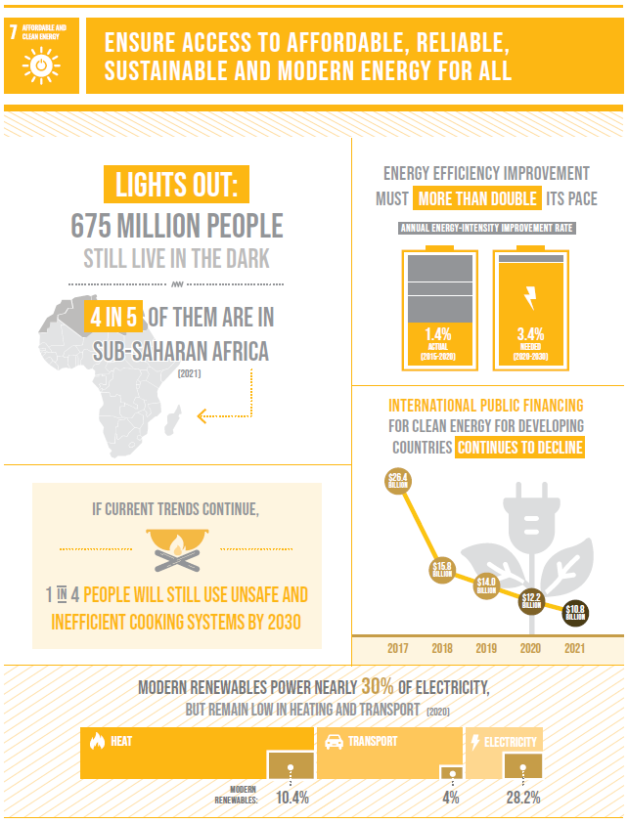
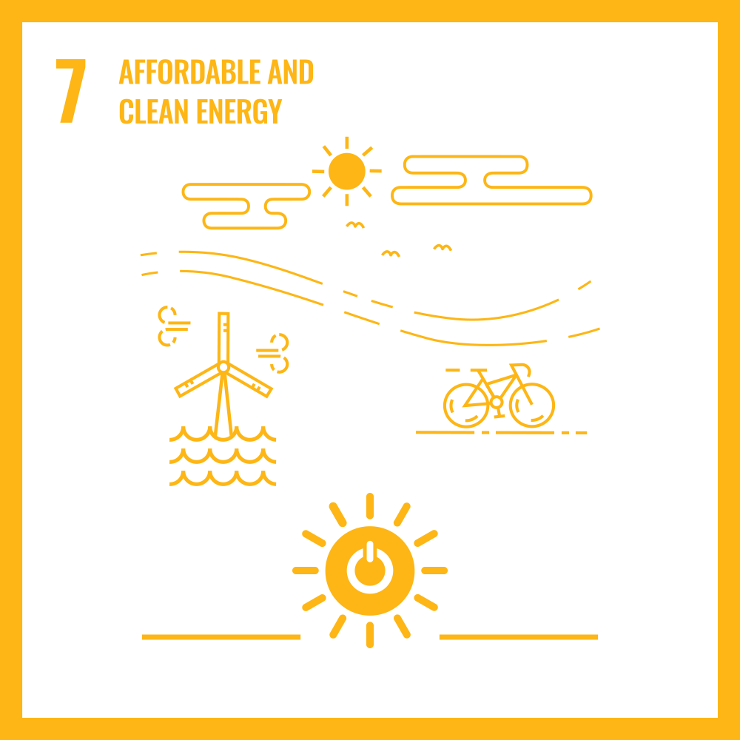

Slide 19
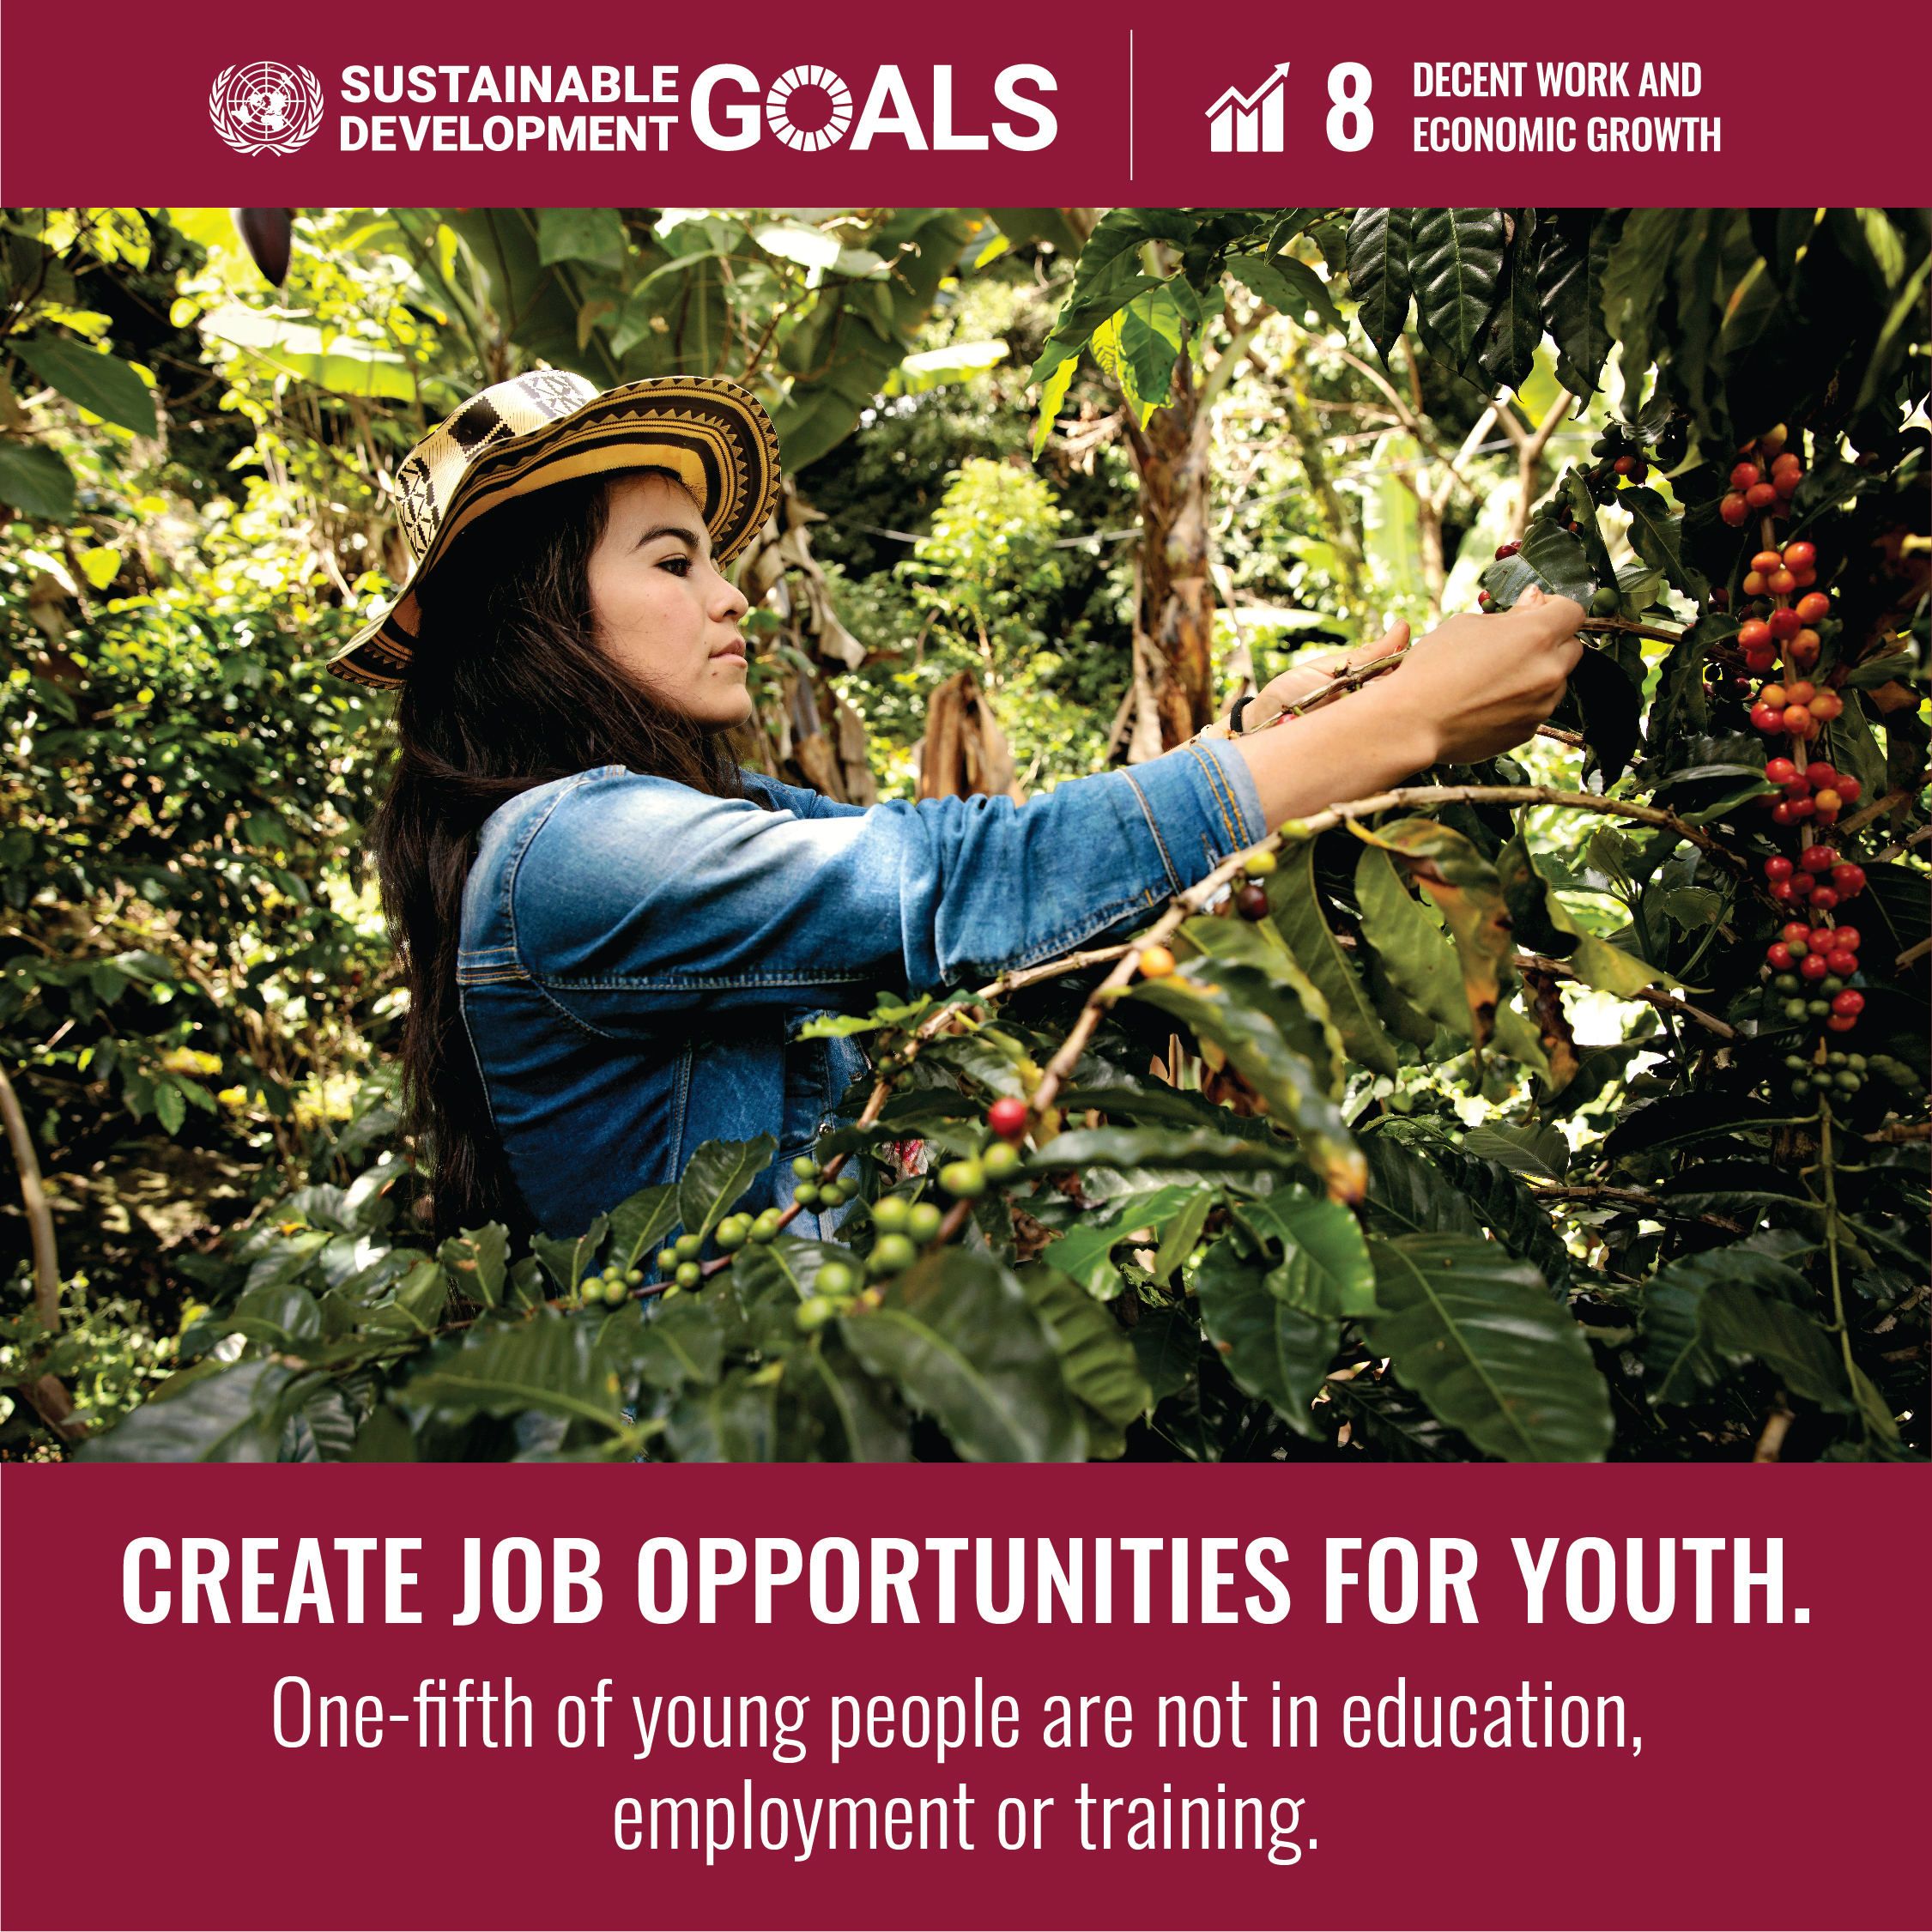
Goal 8 | Decent Work and Economic Growth
Goal 8 focuses on promoting inclusive and sustainable economic growth, employment, and decent work for all.
Multiple crises are threatening the global economy, with global GDP per capita growth forecasted to slow down in 2023. Economic challenges are pushing more workers into informal employment.
While labour productivity has increased and unemployment rates have decreased, more progress is needed to expand employment opportunities, especially for youth, reduce informal employment, address gender pay gaps, promote safe working conditions, and improve access to financial services for sustained economic growth.
The global unemployment rate dropped to 5.4% in 2022, a significant improvement from 6.6% in 2020, marking a recovery from the COVID-19 pandemic and surpassing pre-pandemic levels of 5.5% in 2019.

Slide 20
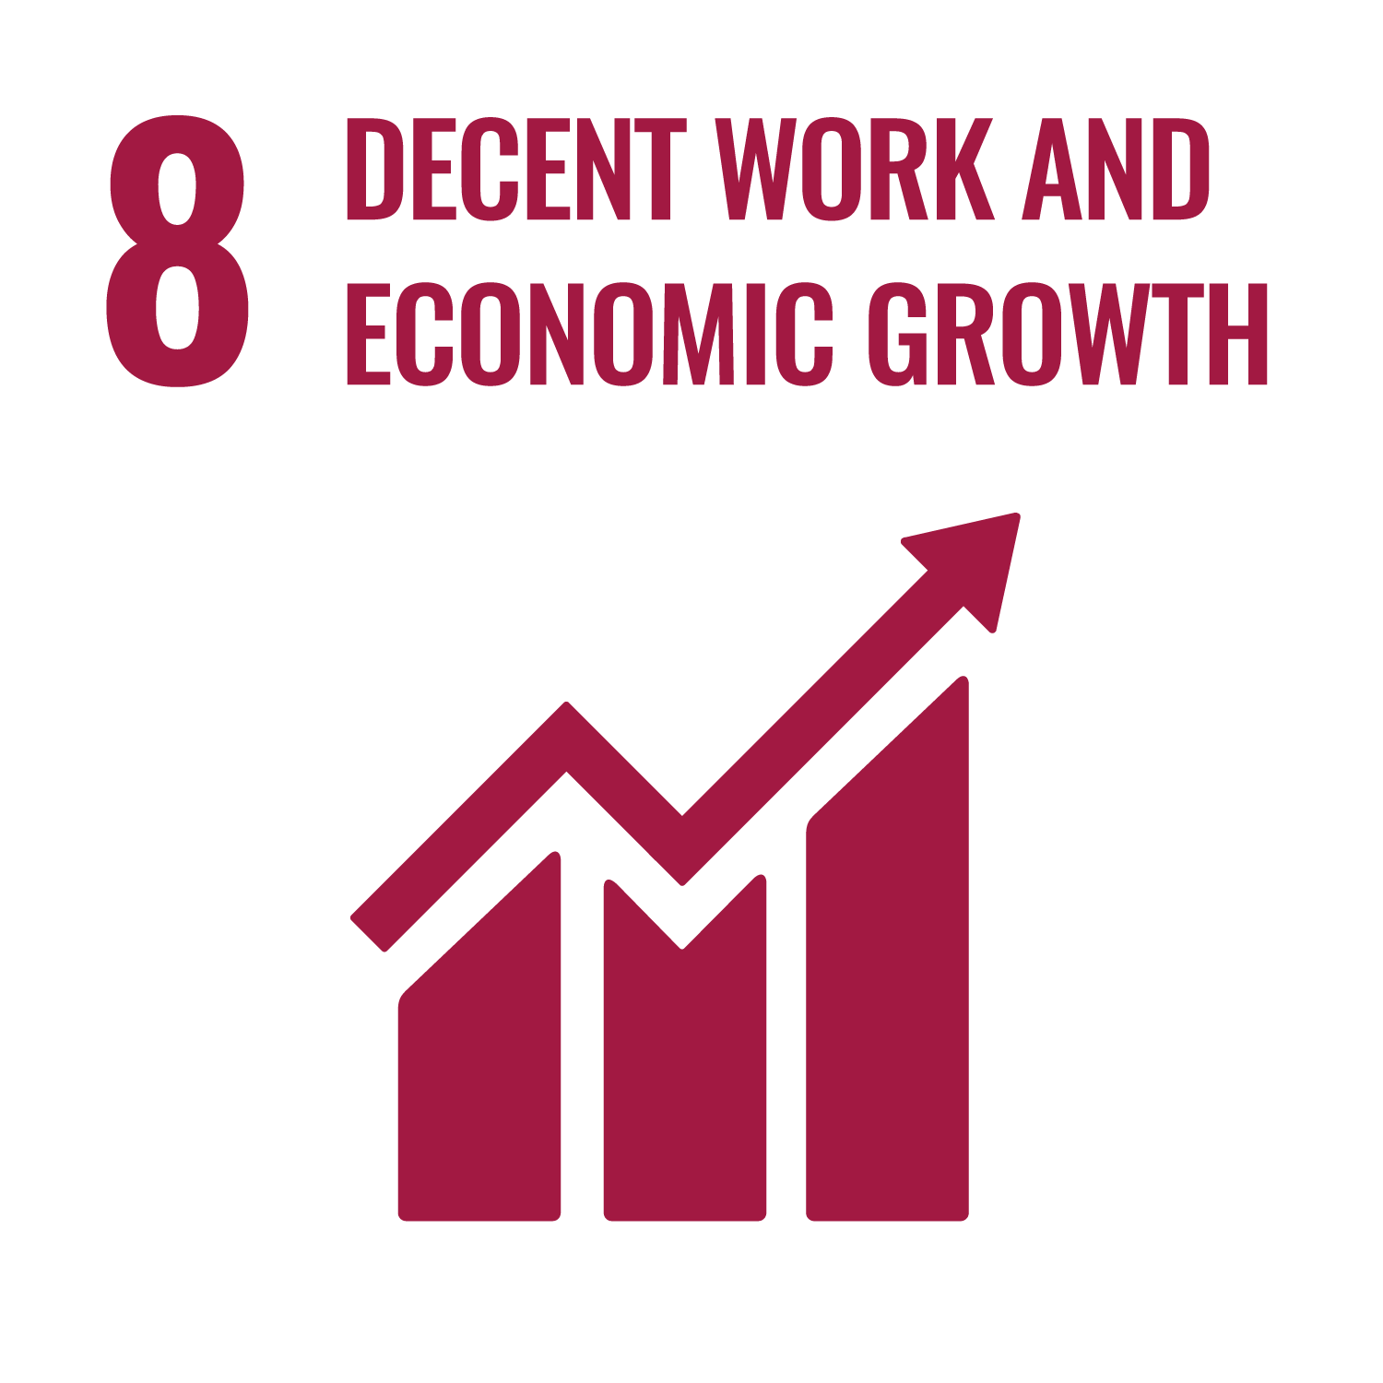
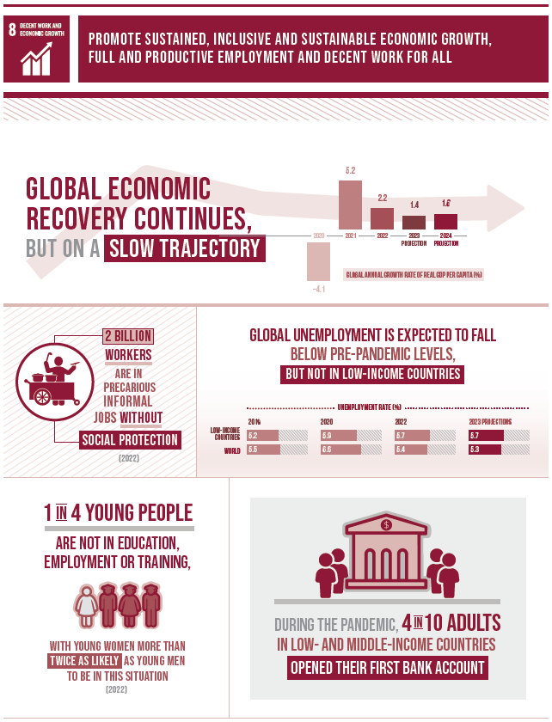


Slide 21

Goal 9 | Industry, Innovation, and Infrastructure
Goal 9 aims to build resilient infrastructure, promote sustainable industrialization, and foster innovation.
Economic growth, social development, and climate action depend on investments in infrastructure, sustainable industrial growth, and technological advancements. In a rapidly changing global landscape with increasing inequalities, growth must prioritize industrialization that is inclusive and supported by innovation and resilient infrastructure.
Even before the COVID-19 pandemic, global manufacturing was declining due to tariffs and trade tensions. The pandemic exacerbated this decline, leading to significant global economic disruptions, driven by high inflation, energy price shocks, raw material shortages, and economic slowdown.
While LDCs in Asia have made notable progress, African LDCs need to accelerate efforts to meet the 2030 target. However, medium-high and high-technology industries have shown robust growth.

Slide 22




Slide 23

Goal 10 | Reduced Inequalities
Inequality undermines long-term social and economic development, hinders poverty reduction, and damages people’s sense of fulfillment and self-worth.
While the incomes of the poorest 40% of the population had been growing faster than the national average in many countries, COVID-19 may have slowed this positive trend, potentially worsening within-country inequality.
The pandemic has also led to the largest rise in between-country inequality in three decades. Reducing both within and between-country inequality requires equitable resource distribution, investment in education and skills development, social protection, combating discrimination, supporting marginalized groups, and fostering international cooperation for fair trade and financial systems.

Slide 24




Slide 25

Goal 11 | Sustainable Cities and Communities
Goal 11 focuses on making cities and human settlements inclusive, safe, resilient, and sustainable.
With the global population reaching 8 billion in 2022, over half live in urban areas. By 2050, 70% of people are expected to live in cities. Currently, 1.1 billion people live in slums or slum-like conditions, with 2 billion more expected in the next 30 years.
However, many cities are not prepared for this rapid urbanization, which outpaces the development of housing, infrastructure, and services, leading to increased slum conditions. Urban sprawl, air pollution, and limited public spaces remain persistent challenges.
Since the SDGs were implemented in 2015, significant progress has been made, with the number of countries having disaster risk reduction strategies doubling. Yet, in 2022, only half of the urban population had convenient access to public transport.
Sustainable development requires transforming how urban spaces are built and managed.

Slide 26




Slide 27

Goal 12 | Responsible Consumption and Production
Goal 12 focuses on ensuring sustainable consumption and production patterns, essential for sustaining the livelihoods of current and future generations.
Our planet is running out of resources, but population growth continues. If the global population reaches 9.8 billion by 2050, we would need almost three planets to sustain current lifestyles.
To address this, we must change our consumption habits and shift to sustainable energy supplies. However, global crises led to a resurgence in fossil fuel subsidies, nearly doubling from 2020 to 2021.
Promising changes are happening in industries, with an increase in sustainability reporting, almost tripling over recent years, reflecting a growing commitment to making sustainability central to business practices.
Food waste is another sign of overconsumption. Tackling food loss requires dedicated policies, investments in technologies, infrastructure, education, and monitoring. A staggering 931 million tons of food are wasted annually, while millions globally face hunger.

Slide 28




Slide 29

Goal 13 | Climate Action
Climate change is a global issue that will affect every person, in every country, and on every continent. It is a looming cataclysm for which we are underprepared.
Human activities are the primary cause of climate change, which threatens life on Earth. With rising greenhouse gas emissions, climate change is happening much faster than anticipated, leading to extreme weather patterns and rising sea levels.
If left unchecked, climate change will reverse years of development progress and trigger mass migrations, instability, and potential conflicts.
To limit global warming to 1.5°C above pre-industrial levels, emissions must be cut by nearly half by 2030, but we are currently off track.
Urgent and transformative actions are necessary, requiring higher ambition, comprehensive economic strategies, and a clear path to net-zero emissions. Immediate measures are essential to avoid catastrophic consequences and secure a sustainable future for future generations.

Slide 30




Slide 31

Goal 14 | Life Below Water
Goal 14 focuses on conserving and sustainably using the oceans, seas, and marine resources, which are crucial for human existence.
The ocean covers three-quarters of the Earth's surface, contains 97% of its water, and provides 99% of the living space on Earth. It offers natural resources, supports waste breakdown, and acts as a carbon sink.
However, marine pollution is escalating, with 17 million metric tons entering the ocean in 2021, set to double by 2040. Plastic is the most harmful pollutant.
The ocean's pH is 30% more acidic than pre-industrial times, threatening marine life and food security.
Careful management, increased funding for ocean science, and urgent action on climate change are essential to protect this fragile resource. Current efforts are insufficient to safeguard it.

Slide 32




Slide 33

Goal 15 | Life on Land
Goal 15 aims to conserve life on land, restore terrestrial ecosystems, manage forests sustainably, and combat land degradation and biodiversity loss.
Earth’s ecosystems sustain life, contribute over half of global GDP, and hold cultural and economic value. However, climate change, pollution, and biodiversity loss are major threats.
Agricultural expansion drives 90% of deforestation, with oil palm causing 7% of global deforestation from 2000 to 2018.
To achieve Goal 15, we need a shift in humanity’s relationship with nature, guided by the Kunming-Montreal Global Biodiversity Framework and its targets for 2030 and 2050.

Slide 34




Slide 35

Goal 16 | Peace, Justice and Strong Institutions
Goal 16 aims to promote peaceful societies, provide access to justice, and build inclusive institutions at all levels. Everyone should be free from violence and feel safe regardless of ethnicity, faith, or sexual orientation.
However, violent conflicts are hindering progress. In 2022, conflict-related civilian deaths increased by 50%, mainly due to the war in Ukraine.
Armed violence and insecurity harm development, with sexual violence, crime, and torture common in areas with conflict or weak rule of law. Countries must protect vulnerable populations.
Governments, civil society, and communities must collaborate to resolve conflicts, strengthen the rule of law, promote human rights, and reduce illicit arms and corruption.

Slide 36




Slide 37

Goal 17 | Partnerships
Goal 17 focuses on revitalizing the global partnership for sustainable development. The 2030 Agenda calls for action by all countries to ensure no one is left behind, requiring partnerships between governments, the private sector, and civil society.
The Sustainable Development Goals can only be achieved through strong global cooperation. However, low and middle-income countries are burdened with rising debt, worsened by COVID-19, inflation, and escalating interest rates.
While official development assistance (ODA) reached record highs, much of the increase in 2022 was due to refugee aid and support for Ukraine.
To succeed, all nations must mobilize resources, with developed countries fulfilling their ODA commitments.

Slide 38




Slide 39

SDGs Implementation in Bangladesh : Targets
SDG 1: End poverty in all its forms everywhere
NPT 1 Reduce the proportion of the population living below the extreme poverty line below 3%
NPT 2 Reduce the proportion of the population living below the national poverty line below 10%
SDG 2: End hunger, achieve food security and improved nutrition, and promote sustainable agriculture
NPT 3 Reduce the prevalence of stunting among children under 5 years of age to 12%
NPT 4 Ensure the proportion of cultivable land at a minimum of 55% of the total land area
Source : https://sdg.gov.bd/
National Prioritized Targets (NPTs) of SDGs for Bangladesh
To ensure Sustainable Development Goals in Bangladesh by leaving no one behind in the shortest time, a set of 39 indicators has been selected under the instructions of the SDG Working Committee of The Prime Minister’s Office. Under these indicators, some are selected from the global Sustainable Development Goals and some are chosen after modification from Bangladesh’s perspective. All relevant ministries relate to this process.

Slide 40
SDGs Implementation in Bangladesh: Targets
SDG 3: Ensure healthy lives and promote well-being for all at all ages
NPT 5 Reduce neonatal mortality rate to 12 per 1,000 live births
NPT 6 Reduce under-5 mortality rate to 25 per 1,000 live births
NPT 7 Reduce the maternal mortality ratio to 70 per 100,000 live births
NPT 8 Reduce death rate due to road traffic injuries to 1.2 per 100,000 people
SDG 4: Ensure inclusive and equitable quality education and promote lifelong learning opportunities for all
NPT 9 Ensure 100% completion rate of primary education
NPT 10 Ensure 100% completion rate of junior secondary education
NPT 11 Ensure the proportion of students in the technical level above 20% of the total students passed every year in secondary education (SSC, Dakhil, and Vocational)
NPT 12 Ensure the proportion of schools by 100% with access to the following:
  Electricity
  Internet
  Basic drinking water
  Single-sex basic sanitation facilities
NPT 13 Ensure the proportion of schools by 100% with access to adapted infrastructure and materials for the child/ students with disability

Slide 41
SDGs Implementation in Bangladesh: Targets
SDG 5: Achieve gender equality and empower all women and girls
NPT 14 Reduce the proportion of women aged 20-24 years who were married before age 15 to zero
NPT 15 Reduce the proportion of women aged 20-24 years who were married before age 18 to 10%
NPT 16 Increase the female labor force participation rate to 50%
SDG 6: Ensure availability and sustainable management of water and sanitation for all
NPT 17 Ensure 100% population using safely managed drinking water services
NPT 18 Ensure 100% population using safely managed sanitation services
SDG 7: Ensure access to affordable, reliable, sustainable, and modern energy for all
NPT 19 Ensure access to electricity for 100% population
NPT 20 Increase renewable energy share in total final energy consumption to 10%
SDG 8: Promote sustained, inclusive, and sustainable economic growth, full and productive employment and decent work for all
NPT 21 Increase annual growth rate of GDP to 10%
NPT 22 Reduce unemployment rate below 3%
NPT 23 Reduce the proportion of youth population (15-29 years) not in education, employment or training to 10%

Slide 42
SDGs Implementation in Bangladesh: Targets
SDG 9: Build resilient infrastructure, promote inclusive and sustainable industrialization, and foster innovation
NPT 24 Ensure 100 percent pucca roads (suitable for all seasons) (SDG Indicator 9.1.1)
NPT 25 Increase Industry (manufacturing) value added as a proportion of GDP to 35%
NPT 26 Increase manufacturing employment as a proportion of total employment to 25%
NPT 27 Increase the number of entrepreneurs ten times in the Information and Communication Technology sector
SDG 10: Reduce inequality within and among countries
NPT 28 Reduce the ratio of income of the top 10% population and the bottom 10% population to 20
NPT 29 Reduce the recruitment cost borne by employees as a proportion of yearly income earned in a country of destination to 10%
SDG 11: Make cities and human settlements inclusive, safe, resilient and sustainable
NPT 30 Ensure women, children, the elderly and persons with disabilities have convenient access to public transport (minimum 20% seats)
SDG 12: Ensure sustainable consumption and production patterns
NPT 31 Ensure 100% of industries install and operate a waste management system

Slide 43
SDGs Implementation in Bangladesh: Targets
SDG 13: Take urgent action to combat climate change and its impacts
NPT 32 Reduce the number of deaths, missing persons, and directly affected persons attributed to disasters to 1500 per 100,000 population
SDG 14: Conserve and sustainably use the oceans, seas, and marine resources for sustainable development
NPT 33 Expand the coverage of protected areas about marine areas by 5%
SDG 15: Protect, restore, and promote sustainable use of terrestrial ecosystems, sustainably manage forests, combat desertification, and halt and reverse land degradation and halt biodiversity loss
NPT 34 Enhance forest area as a proportion of total land area to 18%
NPT 35 Increase the area of tree-covered land by 25% concerning the total land area
SDG 16: Promote peaceful and inclusive societies for sustainable development, provide access to justice for all, and build effective, accountable, and inclusive institutions at all levels
NPT 36 Increase the proportion of children under 5 years of age whose births have been registered with a civil authority to 100%
NPT 37 Increase the proportion of complaint Settlement against cognizance of cases by the National Human Rights Commission to 60%
SDG 17: Strengthen the means of implementation and revitalize the Global Partnership for Sustainable Development
NPT 38 Increase total government revenue as a proportion of GDP to 20%
NPT 39 Increase the proportion of individuals using the Internet to 100%

Slide 44

SDGs Implementation in Bangladesh
| Performance
Source : https://dashboards.sdgindex.org/profiles/bangladesh

Slide 45

Challenges of Implicating SDGs in Bangladesh
Financial Challenge: Hard to arrange the funds needed
Climate Change
Lack of Good Governance
Income and Development Inequalities
Youth Unemployment
For more details: https://www.socialwatch.org/node/18286

Slide 46

To know more about Sustainable Development Goals, you can visit:
https://sdgs.un.org/
https://www.un.org/sustainabledevelopment/

